Slide 1
Join the mission of Wreaths Across America!
Involve Your Community
2025

Slide 2
What is Wreaths Across America?
Wreaths Across America (WAA) is a NATIONAL NON-PROFIT organization, founded in 2007. The annual wreath-laying ceremony at Arlington National Cemetery was started by Maine businessman Morrill Worcester in 1992.
Wreath Across America’s mission is to REMEMBER our fallen U.S. veterans, HONOR those who serve, and TEACH the next generation the value of freedom.
Annually, on NATIONAL WREATHS ACROSS AMERICA DAY each December, wreath-laying ceremonies are held at more than 4,500 cemeteries nationwide and overseas, led by volunteer Location Coordinators. This year, National Wreaths Across America Day is on December 13, 2025.
Wreaths Across America offers YEAR-ROUND PROGRAMS such as the Sponsorship Group Program, Mobile Education Exhibit, Remembrance Tree Tagging, TEACH Program, Wreaths Across America Radio, and Veteran Support Services. Additionally, they provide tours of our National Museum and the Gold Star Family History & Hospitality House in Maine. These initiatives ensure that their mission to REMEMBER, HONOR, and TEACH is upheld throughout the year, fostering lasting connections with veterans and communities nationwide.

Slide 3
How Wreaths Across America REMEMBERS our Fallen U.S. Veterans
During Wreaths Across America’s annual Escort to Arlington, a convoy of trucks travels from Maine to Arlington National Cemetery with wreaths to remember and honor veterans.
The Remembrance Tree Program creates a living memorial for veteran loved ones lost by placing dog tags on the balsam trees that are tipped for making the wreaths placed on veteran graves each December.
The HART Ceremony is conducted each year to honor veterans of our nation’s allies.
Statehouse ceremonies are hosted by Wreaths Across America at state capitols across nearly 50 states. These events bring together local leaders, veterans, and community members to remember and honor veterans.

Slide 4
How Wreaths Across America HONORS Those Who Serve
The popular Wreaths Across America “Thanks-A-Million” campaign gives out free "I Owe You" cards nationwide to express gratitude and honor veterans across the country.
Wreaths Across America participates in veterans' events year-round, including Veterans Day & Memorial Day, and honors veterans through WAA Radio, newsletters, press coverage, on their website, and on social media.
Through their Group Sponsorship program, Wreaths Across America has helped other nonprofits like Civil Air Patrol, Scouts, 4-H Clubs, VFWs, and American Legions raise funds for their own community needs.
The Wreaths Across America Museum at their National Headquarters in Columbia Falls, ME, showcases thousands of donated items, reflecting the organization's rich history and dedication to honoring veterans.

Slide 5
How Wreaths Across America TEACHES the Next Generation the Value of Freedom
Wreaths Across America is dedicated to teaching younger generations the value of freedom and the importance of honoring those who sacrificed to protect it.
They achieve this through their free TEACH K-12 curriculum, providing learning tools, interactive media, and opportunities for schools, 4-H clubs, Scouts, and other youth groups to participate in their mission.
The Mobile Education Exhibit is a traveling classroom designed to inspire and educate the public about Wreaths Across America’s mission and the lives it has touched.
Wreaths Across America’s goal is to bring local communities and military members together through education, storytelling, and interactive experiences.

Slide 6
Look Back at the Wreaths Across America Timeline

Slide 7
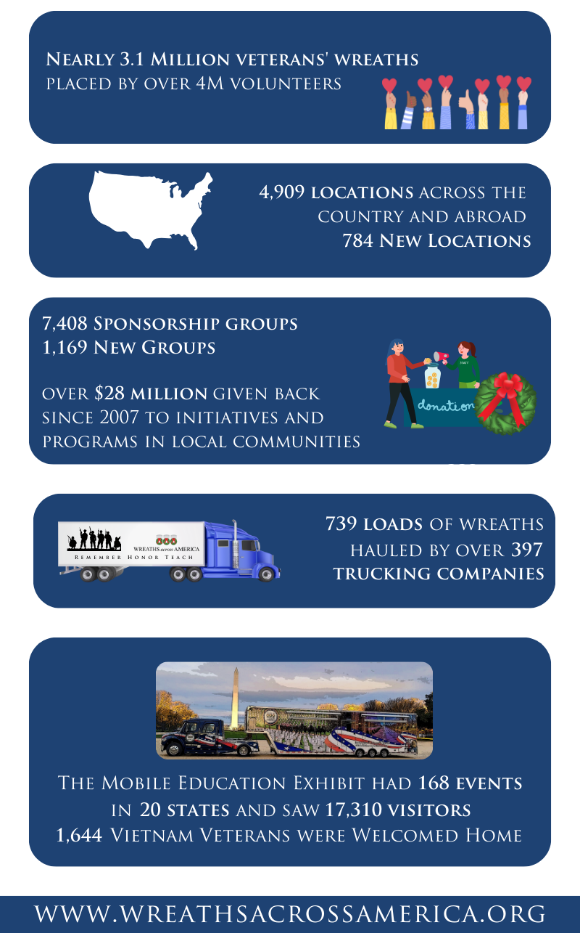
Watch Wreaths Across America Grow!
Thanks to the dedication and support of over 4 million volunteers, 2024 was one of our best years yet. Nearly 3.1 million veteran wreaths were placed at 4,909 participating locations nationwide with the help of 7,408 registered sponsorship groups.
📊 Check out the impact we made together in 2024!
We’re excited to share that since 2007, over $28 million has been given back to local communities across the country through the $5 Back Sponsorship Group Program, enabling groups to do good twice through their own organizations.

Slide 8
How Your Community Can Get Involved
How ALA Can Support Wreaths Across America
Join our Sponsorship Group Program to help gather sponsorships for one of our participating locations!
Take the lead as a Location Coordinator by registering a local cemetery for National Wreaths Across America Day.
Volunteer to help place wreaths at your local participating cemetery on December 13, 2025.
Take part in our year-round programs!

Slide 9
Wreaths Across America Sponsorship Group Program
Choose Your Plan
Select the plan that best fits your group’s goals.
$5 Forward Plan: For every paid wreath sponsorship, $5 will automatically be applied toward another veteran’s wreath sponsorship.
$5 Back Plan: You will get $5 back for every $17 sponsorship. A current-year W9 is required for payback checks and tax purposes.
No Plan: Support our mission by helping cover Wreaths Across America overhead.
How It Works
Sign up: Complete the Sponsorship Group Sign-Up Form. Processing takes 2-3 business days.
Get Started: Receive a welcome email with your Group ID and all the info you need.
Spread the Word: Network within your community to gather sponsorships.
Stay Informed: Receive regular updates and support from headquarters.

Slide 10
More about the $5 Back Plan
$5 Back Plan Details
Your Sponsorship Group will get $5 back for every $17 sponsorship to help you support your own local programs. A current-year W9 is required for payback checks and tax purposes.
Share the direct link to the custom Wreaths Across America Sponsorship Group page that is created for your organization to gather sponsorships online!
Collect checks written out to Wreaths Across America and submit them through the mail with approved order forms within 30 days of receiving the checks.
Payback checks are issued on the 15th of each month, February to November, making this a wonderful way to fundraise for your organization all year round!
The $5 Back Plan Makes a Difference!
Since 2007, WAA has given back $25M to Sponsorship Groups.

Slide 11
Getting Started as a Sponsorship Group
How ALA Can Support Wreaths Across America
Join your Regional Welcome Webinar!
Watch for an invite.
Find Planning Tools, Marketing Materials, Volunteer Tutorials, and more on the Volunteer Resource Page .
Create a team of local volunteers to help you with your efforts.
Connect with your Regional Liaison Team for 1:1 support all year round!

Slide 12
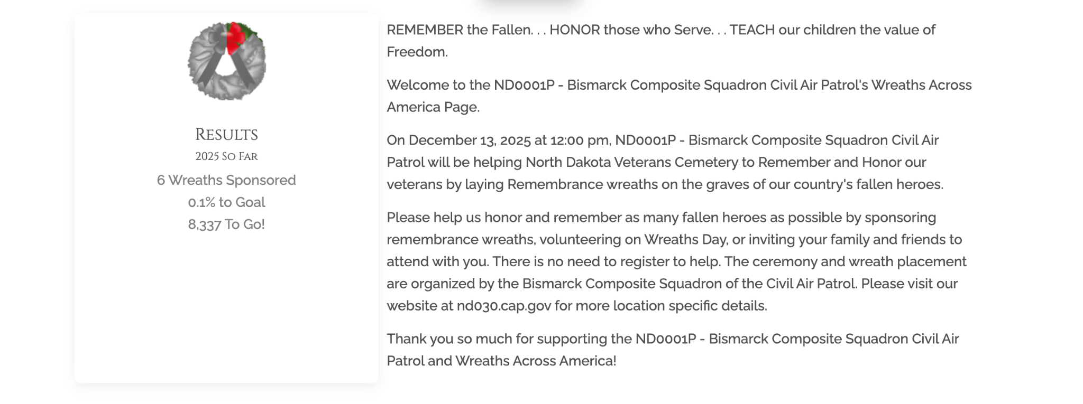
Ways to Customize Your WAA Group Page
Every registered Sponsorship Group receives a dedicated Wreaths Across America page, which can be customized to highlight your organization's efforts while easily accepting online donations.
Here are some customization options:
Banner Image: Include a photo of your local cemetery or organization placing wreaths there.
Logo: Upload your logo to showcase your organization.
Text: Edit all text to share upcoming fundraising events and highlight your organization's achievements.
Additionally, the live wreath-o-meter displays up-to-date wreath counts, encouraging supporters to help you reach your goal!

Slide 13
Customized WAA Resources
Once registered as a Sponsorship Group, your organization will receive customized resources to assist with fundraising. These resources include:
Custom QR Code: Links directly to your WAA group page for easy online sponsorships.
Order Form: Tailored for your Sponsorship Group.
Tally Sheet: Designed for submitting multiple sponsorships at a time.
WAA Day Poster: Customized for your Sponsorship Group and the locations you support.
Print the WAA Day Poster as a flyer to distribute at fundraising events. You can add the Order Form to the back of the flyer, making it convenient for supporters to sponsor wreaths either online or by mail.

Slide 14
Ask for Local Support
Your community wants to help!
Hold fundraising events to gather sponsorships & share the WAA mission with your community.
Reach out to local businesses for grants to cover wreath sponsorships.
Use the WAA Fundraising Idea Guide on the Volunteer Resource Page to help plan events.

Slide 15
Use Social Media for Quick Fundraising
Create a Facebook Page for your Sponsorship Group and encourage your community to get involved in the Wreaths Across America mission!
COMPETITION AMONG MEMBERS Have your members share their individual WAA member pages on social media asking friends and family to support their efforts.
WREATH-O- METER Share the progress towards meeting your goal and the direct link to your group page.
FACEBOOK FUNDRAISER Hold a Facebook Fundraiser for your birthday or other event. Complete the Facebook Notification Form on the Volunteer Resource Page so that your Group and Location receive credit!
Be sure to always share the direct link for your WAA Group Page in your posts.
Use the Monthly Messaging Guide to share content with WAA branded graphics! Find it on the Volunteer Resource Page under Marketing Materials for Social Media, and on the private Facebook groups.

Slide 16
Expand Your Reach with Year-Round WAA Programs
TEACH Program
Use the free K-12 Educational Curriculum.
Mobile Education Exhibit (MEE)
It travels the country to spread patriotism & love of country.
Remembrance Tree Program
Place a Dog Tag for your veteran loved ones.
WAA Radio & Resources for Veterans
Share these with your community!

Slide 17
Listen to Wreaths Across America Radio!
Wreaths Across America Radio is a 24/7 internet stream, perfect for sharing your stories of service within your community and your support of the mission of Wreaths Across America.
Tune in for the live morning show every weekday from 6am to 10am ET for various programs produced by and/or relating to veterans, and so much more!
To schedule a time to share your story, contact Jeff Pierce at jpierce@wreathsacrossamerica.org.
Listen anywhere at www.wreathsacrossamerica.org/radio or via the iHeart Radio app, TuneIn, Simple Radio apps, or download it from the App Store or Google Play.

Slide 18
Contact Us!
Got questions? We’re here to help! A team member is standing by and will connect you with your Regional Liaison Team.
Wreaths Across America Address
Headquarters: 4 Point Street Columbia Falls, ME 04623
Mailing: PO BOX 249 Columbia Falls, ME 04623
Phone & Email
Customer Service: (877) 385-9504
Email: info@wreathsacrossamerica.org
Social Media
Facebook: https://www.facebook.com/WAAHQ
Instagram: https://www.instagram.com/wreathsacross/
Twitter: https://twitter.com/WreathsAcross
TikTok: https://www.tiktok.com/@wreathsacross
LinkedIn: https://www.linkedin.com/company/wreaths-across-america/
YouTube: https://www.youtube.com/WreathsAcrossAmerica
Videos to Learn More
Wreaths Across America: Our History, Tradition and Mission
What is a Veterans' Wreath?

Slide 19
Region 1 Liaison Team
207-578-6277
region1@wreathsacrossamerica.org
Regional Map
Washington
New
Hampshire
Montana
Maine
Region 2 Liaison Team
207-578-6283
region2@wreathsacrossamerica.org
North Dakota
Minnesota
Vermont
Oregon
Idaho
South Dakota
Wisconsin
Michigan
New York
Massachusetts
Wyoming
Rhode Island
Nevada
Nebraska
Iowa
Pennsylvania
Connecticut
Region 3 Liaison Team
207-578-6287
region3@wreathsacrossamerica.org
Utah
Illinois
Ohio
New Jersey
Colorado
Indiana
West Virginia
Delaware
California
Kansas
Virginia
Maryland
Missouri
Kentucky
** Region 5 Includes DC
Tennessee
North Carolina
Arizona
Oklahoma
Arkansas
South
Carolina
Region 4 Liaison Team
207-578-6284
region4@wreathsacrossamerica.org
New Mexico
Mississippi
Georgia
Alabama
Texas
** Region 2 includes Puerto Rico, Virgin Islands, & Cuba
Louisiana
Florida
Region 5 Liaison Team
207-578-6289
region5@wreathsacrossamerica.org
Alaska
Hawaii
** Region 4 Includes Guam
Notes:
It can be found at the top of the Volunteer Resource Page.
When you contact your Regional Liaison Team, please keep in mind they assist volunteers in several states and it may take them a day or two to get back to you.
We want to give all of our volunteers the 1:1 support they need, so when they get back to you, rest assured they will take their time to get all of your questions answered.

Slide 20
THANK YOU!

