Slide 1
Wreaths Across America

Slide 2
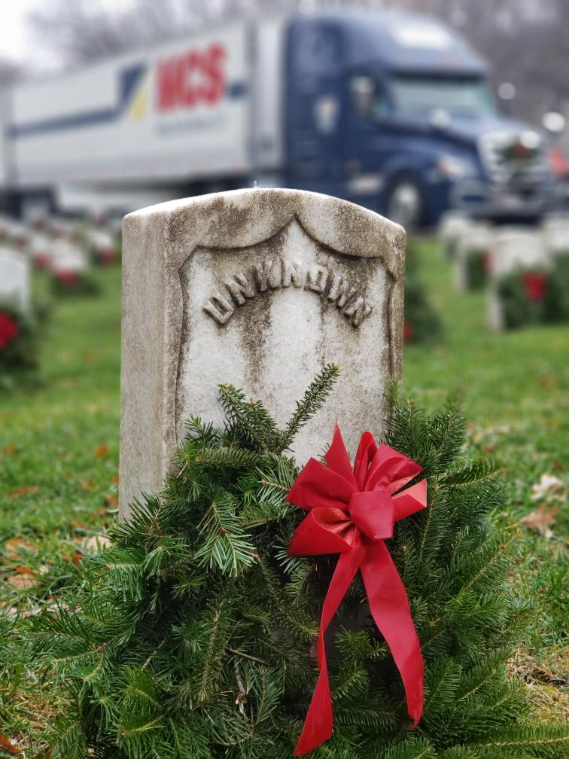
What is
Wreaths Across America?
National nonprofit organization
Founded in 2007
Continues to expand
Annual wreath-laying ceremony at Arlington National Cemetery begun by Maine businessman Morrill Worcester in 1992.

Slide 3
Remember the Fallen…
How We Remember
WAA’s annual pilgrimage from Columbia Falls, Maine, to Arlington National Cemetery in Virginia
The Remembrance Tree Program provides a living memorial to loved ones lost
The HART Ceremony is conducted each year to honor veterans of our nation’s allies
WAA hosts statehouse ceremonies in nearly 50 states.

Slide 4
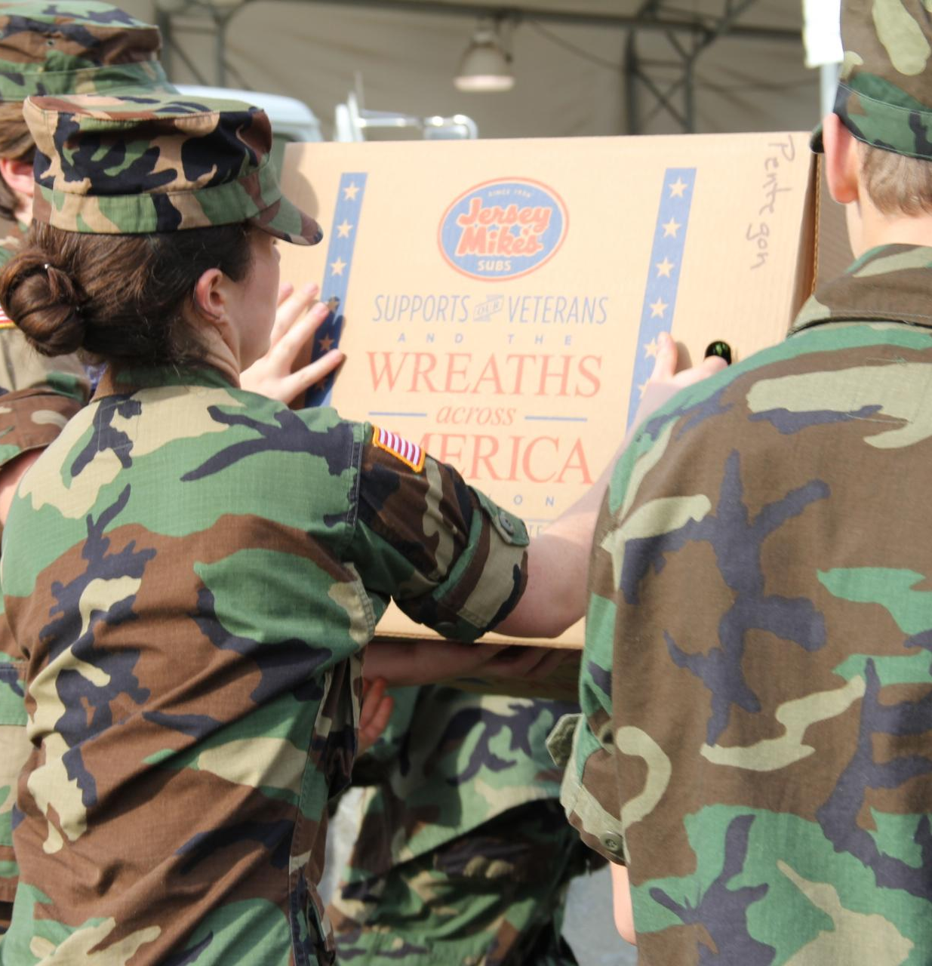
How We Honor
Honor those that Serve and their families…
WAA conducts several programs to honor our veterans, including our popular Thanks-A-Million campaign, which distributes free “I Owe You” cards to people all over the country
The organization participates in veterans’ events throughout the year through Veterans Day, Memorial Day, WAA Radio, in our monthly newsletters, in press coverage and on the website and social media
Through WAA’s group sponsorship program, WAA has helped other nonprofits such as Civil Air Patrol, Scouts, 4-H Clubs, local VFWs and American Legions raise funds for their own community needs
The WAA Museum located at the National HQs in Columbia Falls, ME, and showcases thousands of items that have been donated to WAA over the decades
Wreaths Across America has new and expanding Military and Veterans Outreach program.

Slide 5
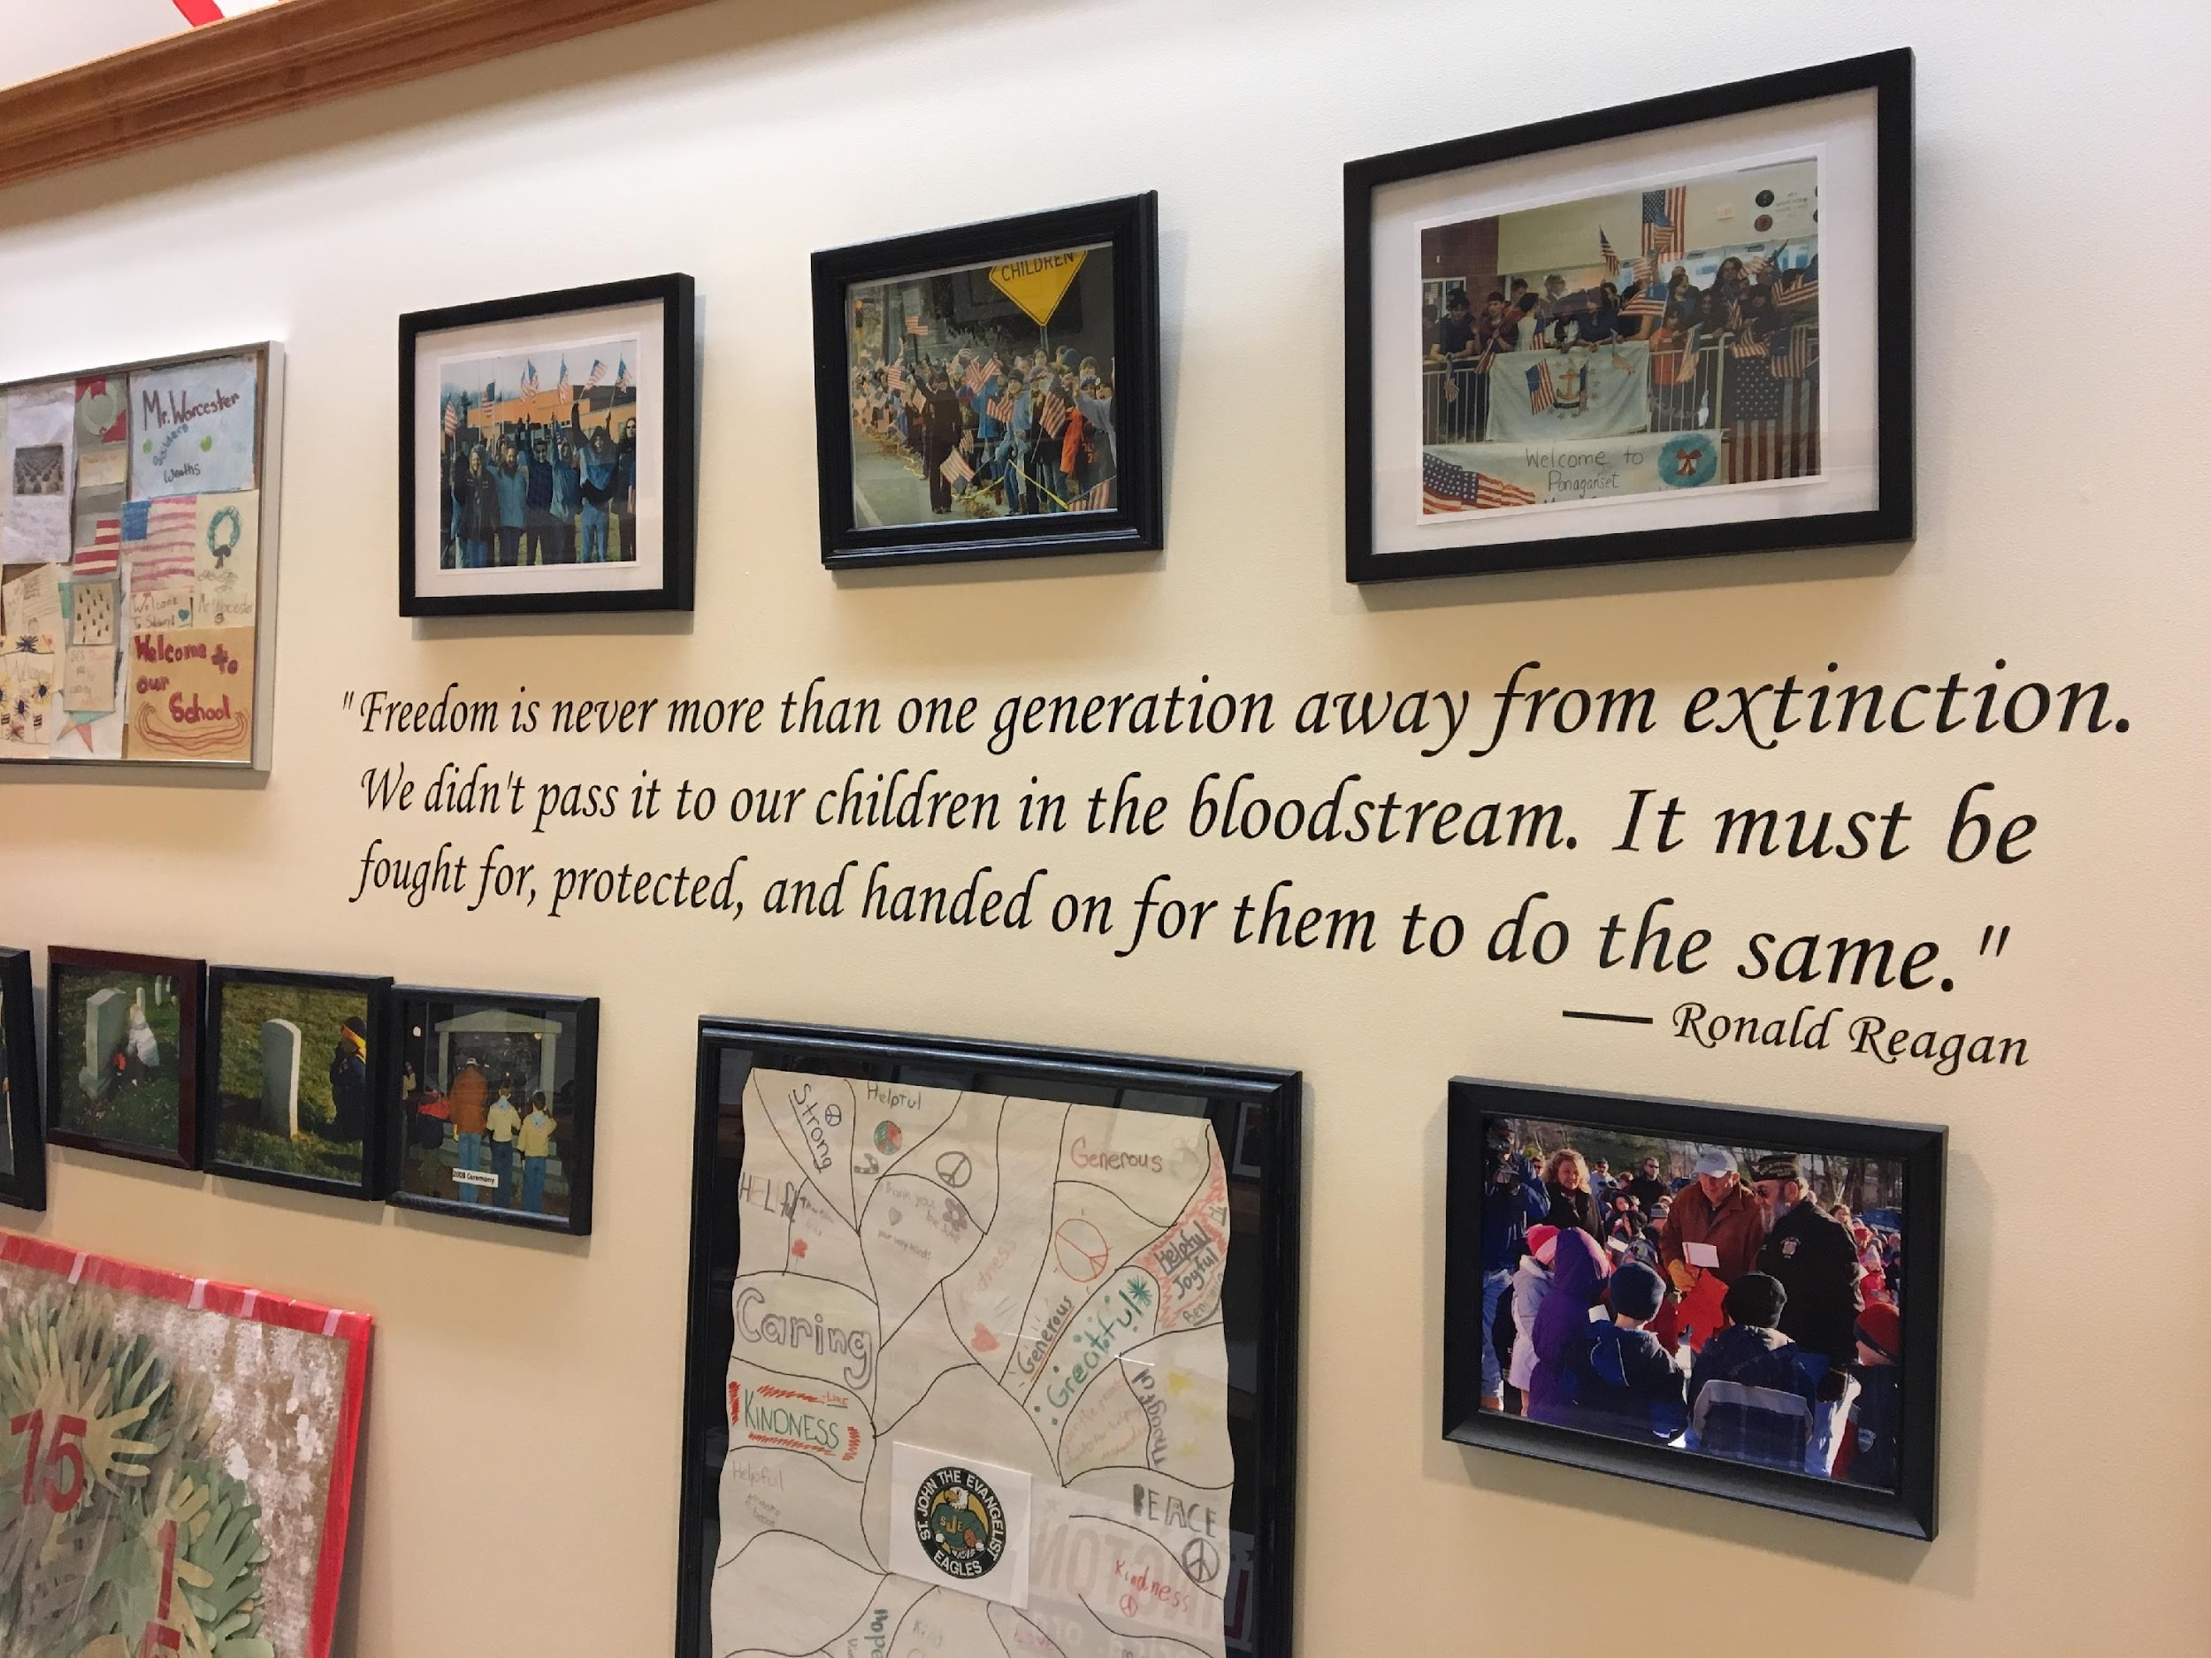
Teach the next generation about the value of freedom…
How We Teach
WAA is committed to teaching younger generations about the value of their freedoms and the importance of honoring those who sacrificed so much to protect those freedoms. We offer learning tools, interactive-media projects and opportunities for schools, 4-H clubs, Scouts and other youth groups to participate in our efforts.
The Mobile Education Exhibit is a traveling classroom on wheels designed to inspire and educate all about the mission and those who lives have been impacted by it. The goal of the Wreaths Across America Education Exhibit is to bring local communities and our military together with education, stories and interactive connections.

Slide 6
Growth by Region
6,717+ local sponsorship groups
in all 50 states
4,224+ participating locations
in addition to Arlington National Cemetery

Slide 7
First wreaths (5,000) donated by Morrill Worcester and Worcester Wreath Co.
1992
Iconic photo of wreaths in snow became a viral sensation
2005
With the help of the CAP and other civic organizations, simultaneous wreath-laying ceremonies were held at over 150 locations around the country.
2006
Wreaths Across America formed as a 501(c)(3) nonprofit organization
2007
Millionth wreath placed at Arlington National Cemetery
2012
For the first time, every headstone at Arlington National Cemetery received a wreath.
2014
25th year that veterans’ wreaths were placed at Arlington National Cemetery.
2016
Mission advances overseas with the first placement of 9,387 veterans’ wreaths at Normandy-American Cemetery in France.
2018
3 million veterans’ wreaths placed at more than 4,224 participating locations across the country!
2023
Notes:
Just to give a brief history of Wreaths Across America over the years.
In 1992 the first 5,000 wreaths were donated by Morrill Worcester and Worcester Wreath Company.
In 2005, the iconic photo of wreaths in snow became a viral sensation.
In 2006, With the help of the Civil Air Patrol and other civic organizations, simultaneous wreath-laying ceremonies were held at over 150 locations around the country.
In 2007, Wreaths Across America was formed as a 501c3 Nonprofit Organization.
In 2012, the millionth wreath was placed at Arlington National Cemetery
In 2014, for the first time, every headstone at Arlington National Cemetery received a wreath.
2016 was the 25th year that veterans wreaths were placed at Arlington National Cemetery.
In 2018 the mission advanced overseas with the first placement of 9,387 veterans wreaths at the Normandy- American Cemetery in France
In 2019 there were 2.2 million veterans wreaths placed at more than 2,100 participating location's across the country.

Slide 8
Sponsorship Groups
Options
There are THREE types of sponsorship groups that you can sign up for to raise money for a specific cemetery location(s) or to give to WAA to allocate wreaths where most needed.
The sponsorship group will benefit directly from being a $5-Back Group
1
$5-Back Group
2
3-for-2 Group
3
No Plan Group

Slide 9
$5-Back Group
Designed for other nonprofits and civic groups to benefit from.
For every $17 wreath sponsorship sold, your registered group will receive $5 back for your own program.
All sponsorships are sent to WAA HQ in Maine for processing
At the end of each month WAA sends a pay back check
$23M
Over the years, WAA has given back to these groups

Slide 10
Join the Mission
1
Select a participating location you will raise funds for.
2
Register your group online at https://www.wreathsacrossamerica.org/GetInvolved/LeadASponsorshipGroup
3
Create your custom sponsorship page.
4
Promote your sponsorship web page.
5
Host fundraising events in your community!
6
Fundraising can be done year-round!

Slide 11
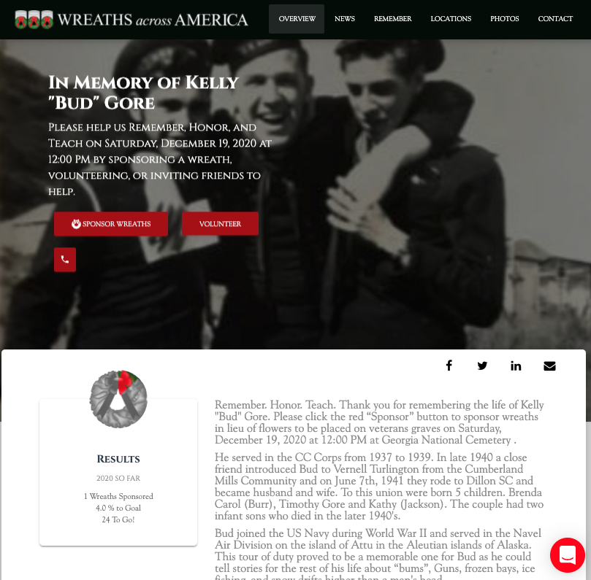
In Lieu of Flowers Program
Our In Lieu of Flowers program is specifically for veterans who have recently passed. This is a special way to memorialize the life and service of our veterans. Instead of encouraging loved ones to send flowers to the family of the veteran who has recently passed, we will create a custom page for the veteran and help the family customize it with a photo and biography, so that loved ones can sponsor veteran wreaths in their honor.
On these customized pages family and friends can also upload a photo of the veteran and write a personal message to be displayed on their Remember Wall.
There will be a direct link to their In Lieu of Flowers page that they can share to help further their legacy through sponsored veteran wreaths. To request an In Lieu of Flowers page be made that can be done online at www.wreathsacrossamerica.org.
Notes:
In addition to the wreath laying ceremony in December, Wreaths Across America also offers several other opportunities to honor and remember our nation’s heroes all year round.
One of these is the In Lieu of Flowers program, which is specifically for veterans who have recently passed. This is a special way to memorialize the life and service of our veterans. Instead of encouraging loved ones to send flowers to the family of the veteran who has recently passed, we will create a custom page for the veteran and help you customize it with their photo and biography, and loved ones can sponsor veteran wreaths in their honor. This is also where loved ones can upload a photo of the veteran and write a personal message to be displayed on their Remember Wall. There will be a direct link to their In Lieu of Flowers page that you can share with your community to help further their legacy through sponsored veteran wreaths. If this is something you are interested in, let me know and I’ll help you set it up!
You’ll also find some helpful volunteer resources on our new Wreaths Across America website! Just go to www.wreathsacrossamerica.org and click on ‘Get Involved’ to find everything that you will need.
We have most documents already templated to help make your job easier! However, if you are planning to customize any materials, we will need to approve them before you do any printing or distribution. Go ahead and email me the draft of your custom document and I’ll run it by our Communications Director for approval.

Slide 12
Region 1 Liaison Team
Terra Delong & Emily Carney
207-578-6277
region1@wreathsacrossamerica.org
Regional Map
Washington
New
Hampshire
Montana
Maine
Region 2 Liaison Team
Miesa Bland & Janelle Eveld
207-578-6283
region2@wreathsacrossamerica.org
North Dakota
Minnesota
Vermont
Oregon
Idaho
South Dakota
Wisconsin
Michigan
New York
Massachusetts
Wyoming
Rhode Island
California
Nevada
Nebraska
Iowa
Pennsylvania
Connecticut
Region 3 Liaison Team
Stephanie Molina & Ana Diaz
207-578-6287
region3@wreathsacrossamerica.org
Utah
Illinois
Ohio
New Jersey
Colorado
Indiana
West Virginia
Delaware
Kansas
Virginia
Maryland
Missouri
Kentucky
** Region 5 Includes DC
Tennessee
North Carolina
Arizona
Oklahoma
Arkansas
South
Carolina
New Mexico
Region 4 Liaison Team
Amber Rocha & David Koskelowski
207-578-6284
region4@wreathsacrossamerica.org
Mississippi
Georgia
Alabama
Texas
** Region 2 includes Puerto Rico, Virgin Islands, & Cuba
Louisiana
Florida
Region 5 Liaison Team
Tiffany Lynch & Annie Brooks
207-578-6289
region5@wreathsacrossamerica.org
Alaska
Hawaii
** Region 4 Includes Guam
Notes:
Here is a map that shows you which states are covered by each Regional Liaison Team. This map is located on the Volunteer Resource Page and can be accessed at anytime.

Slide 13
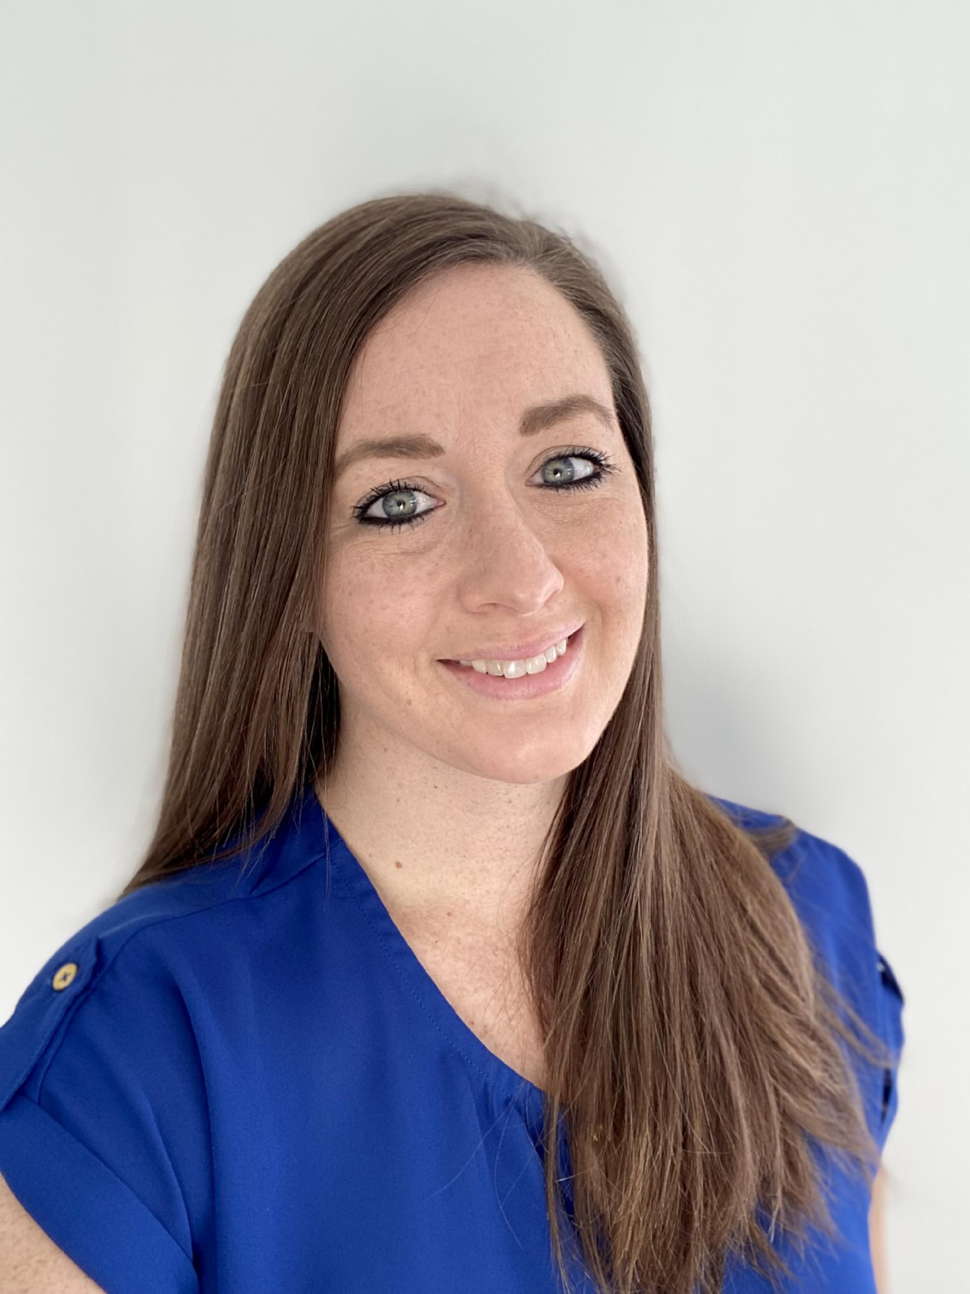
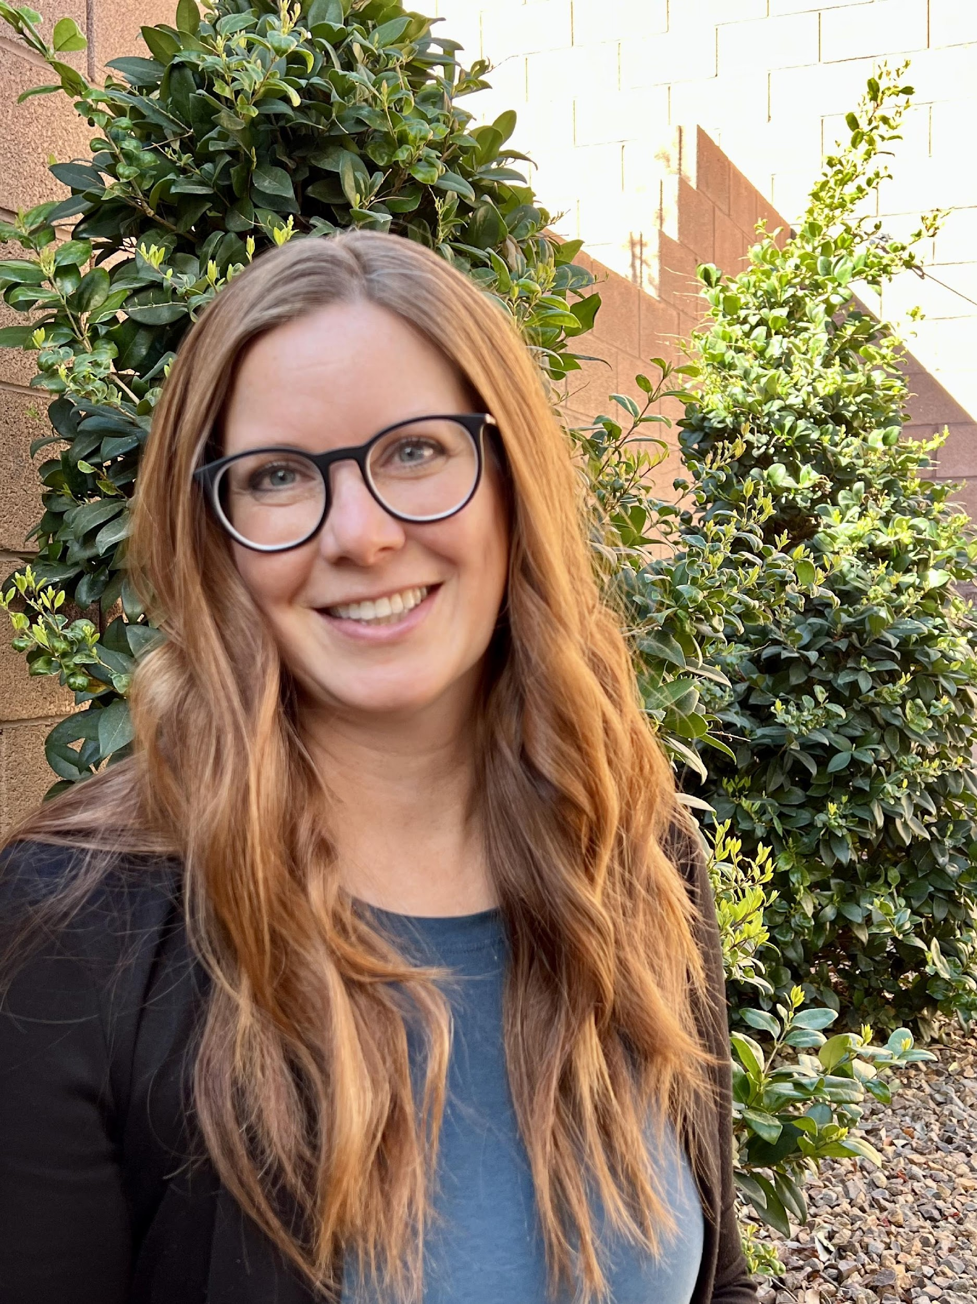
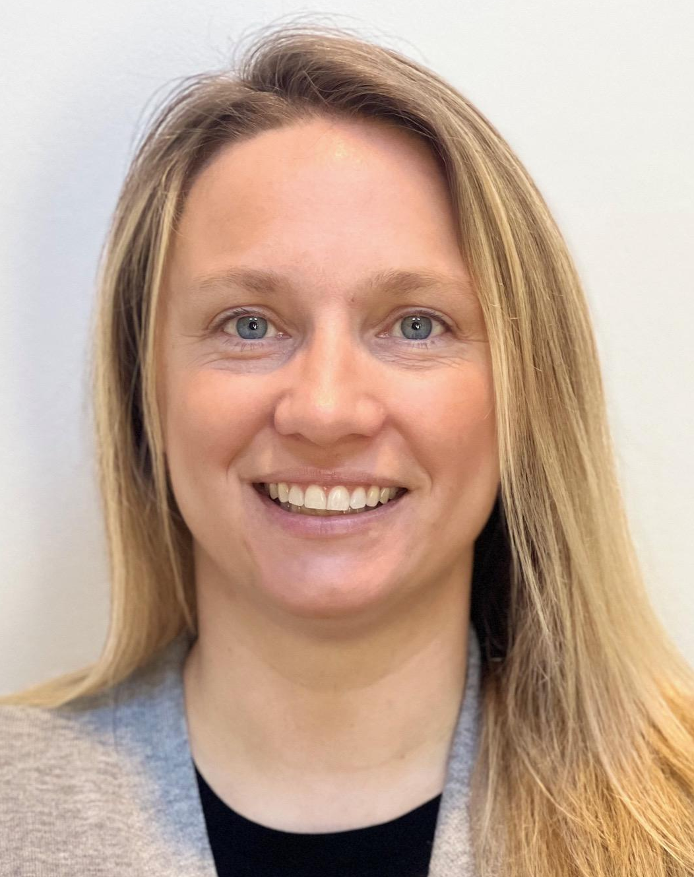
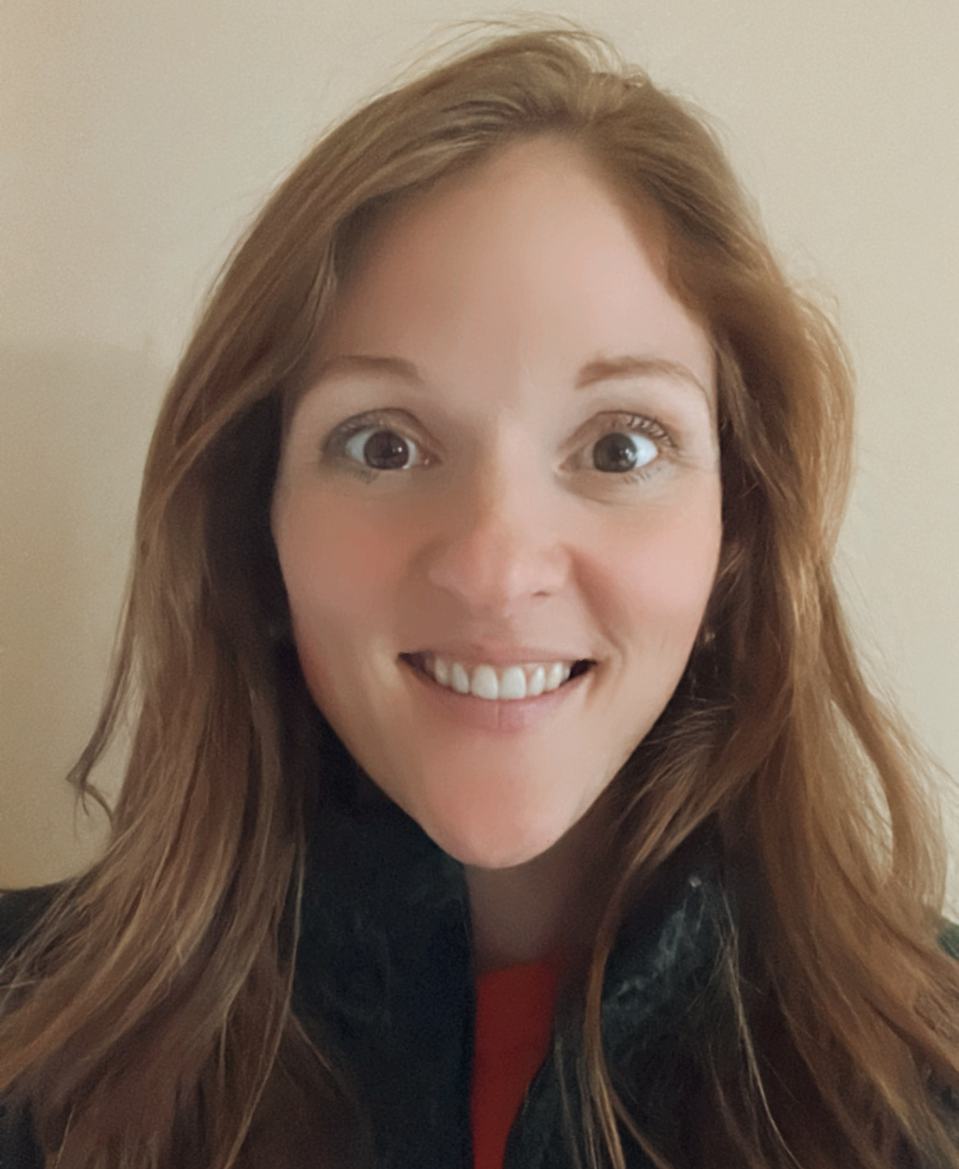
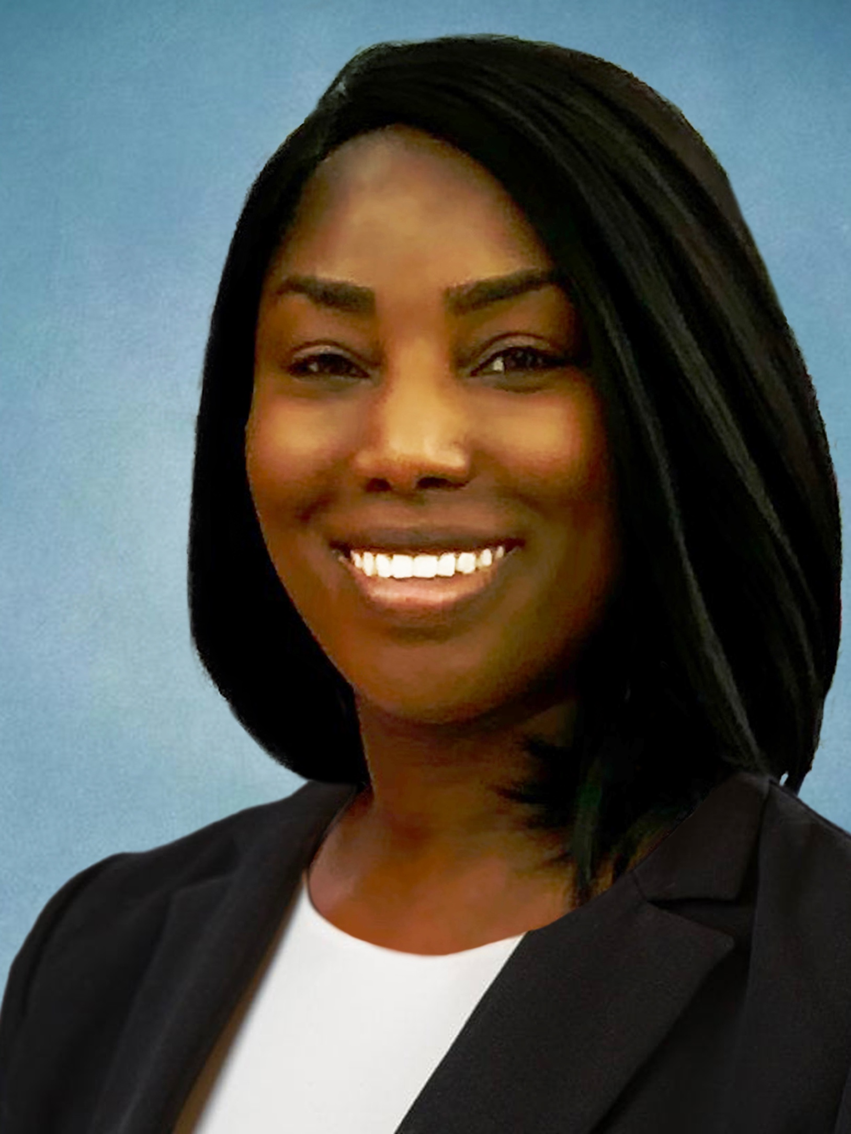
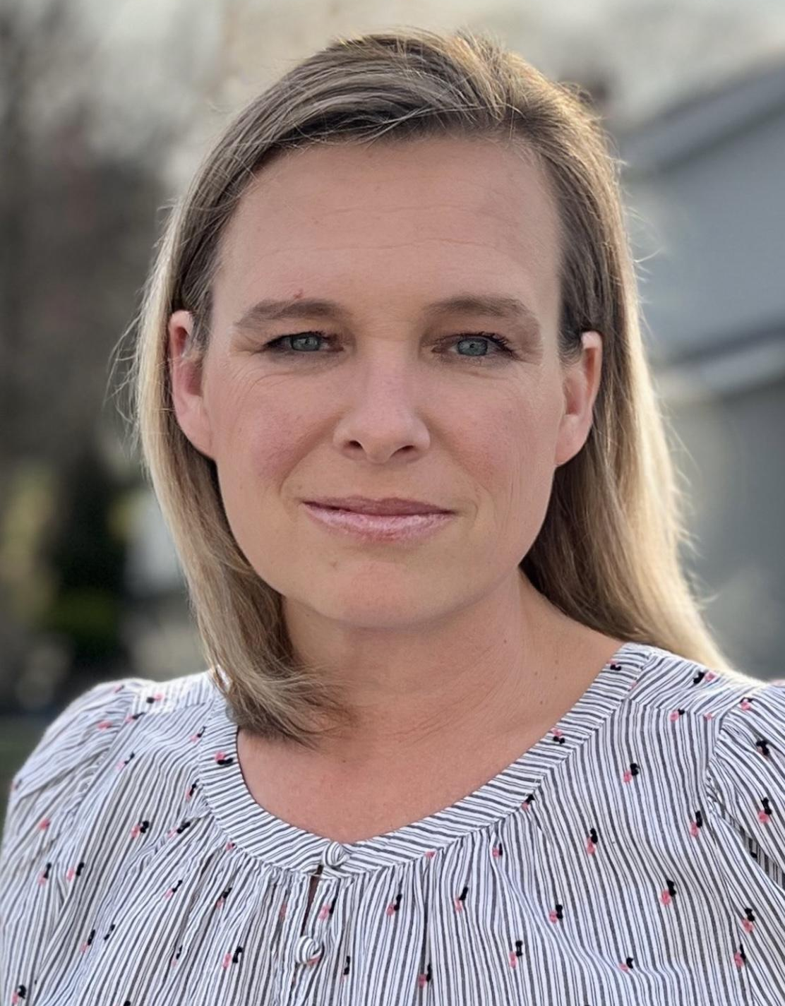
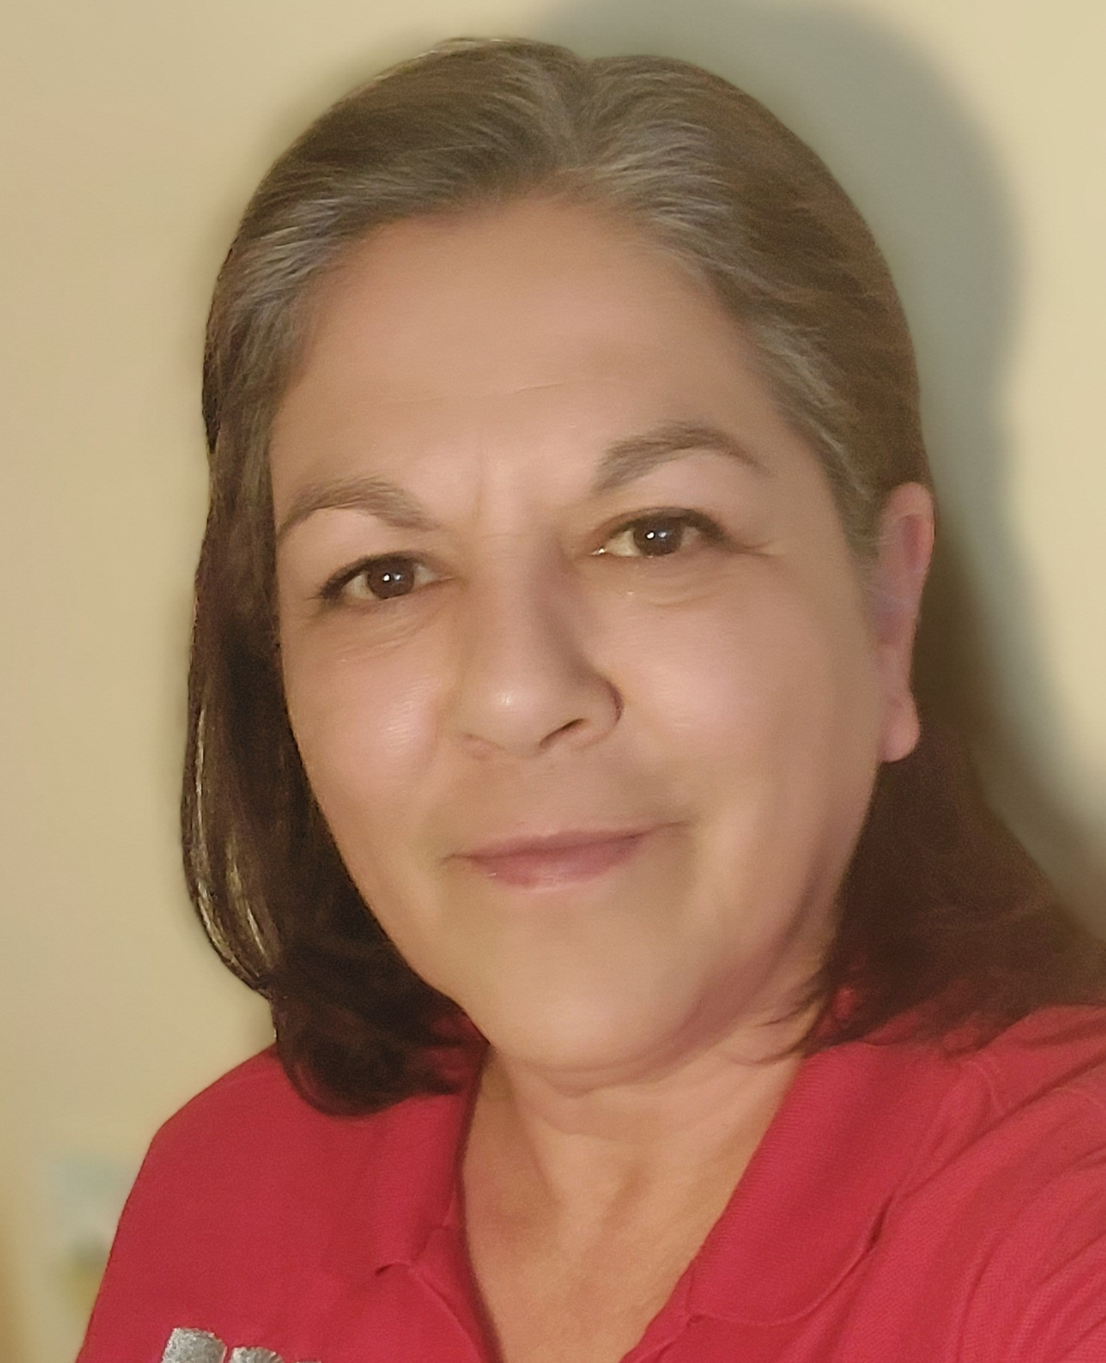
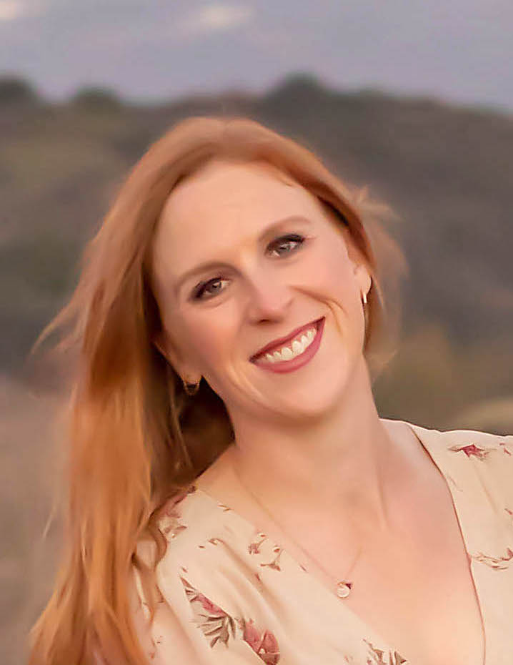
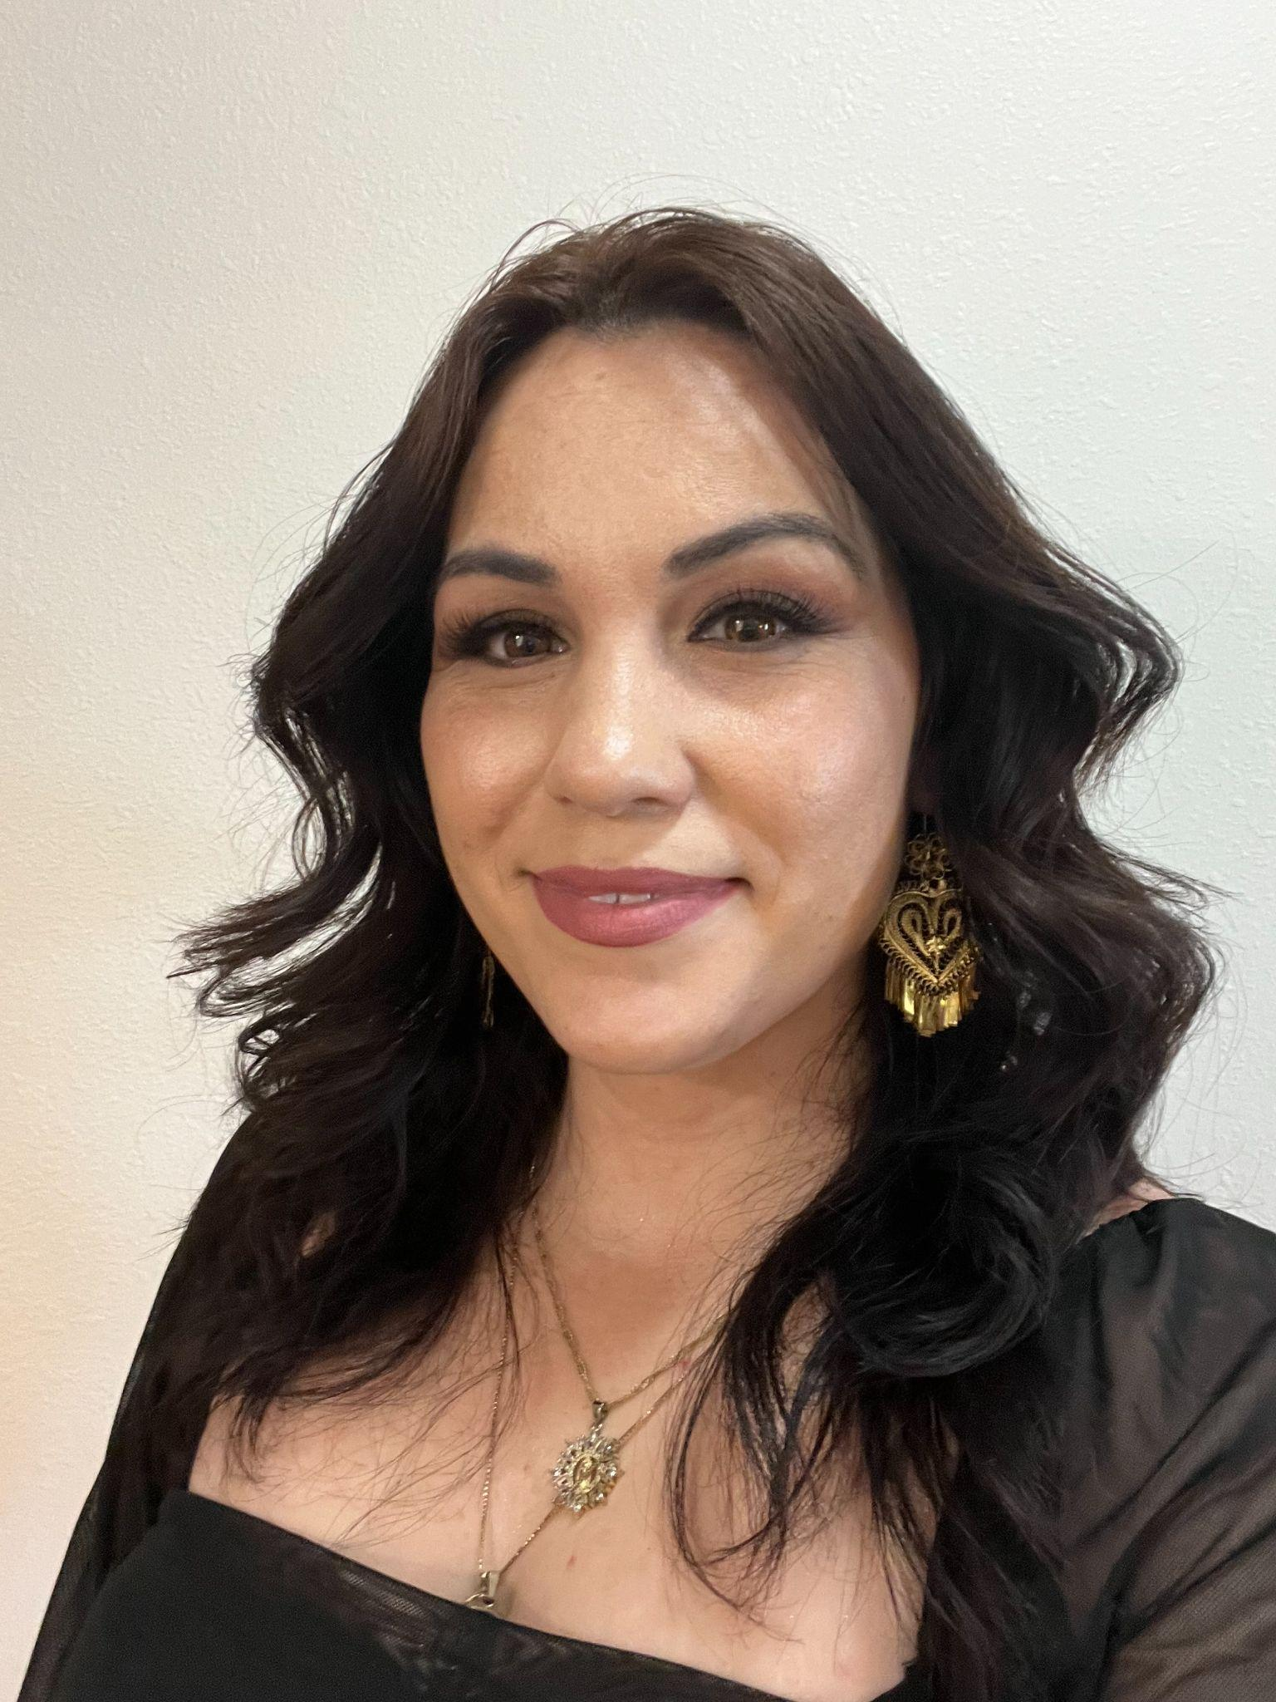
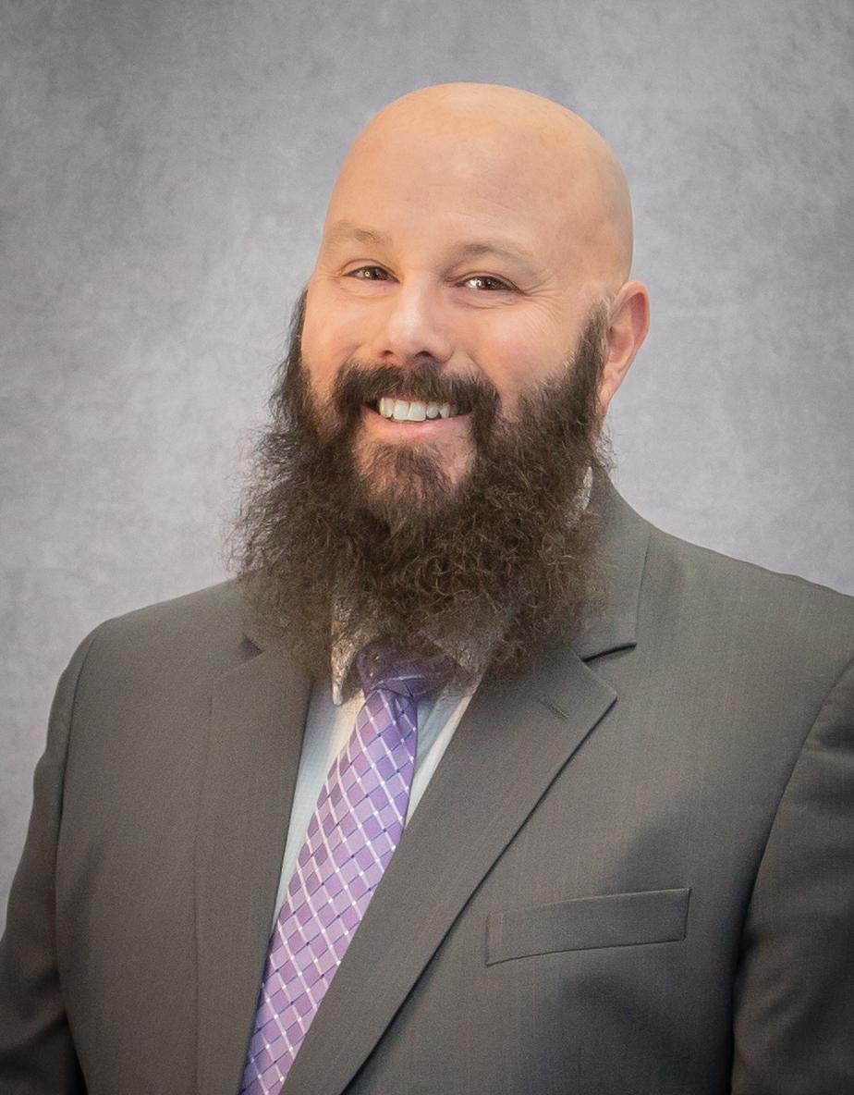
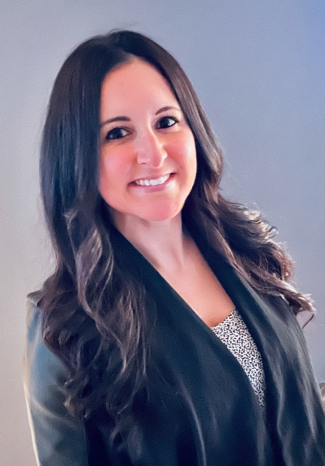
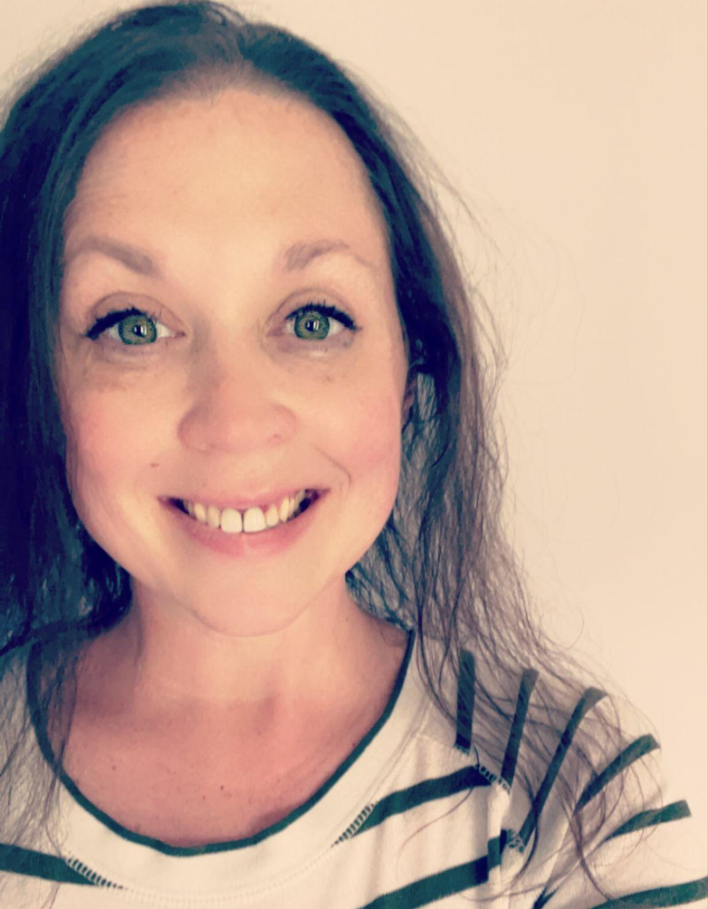
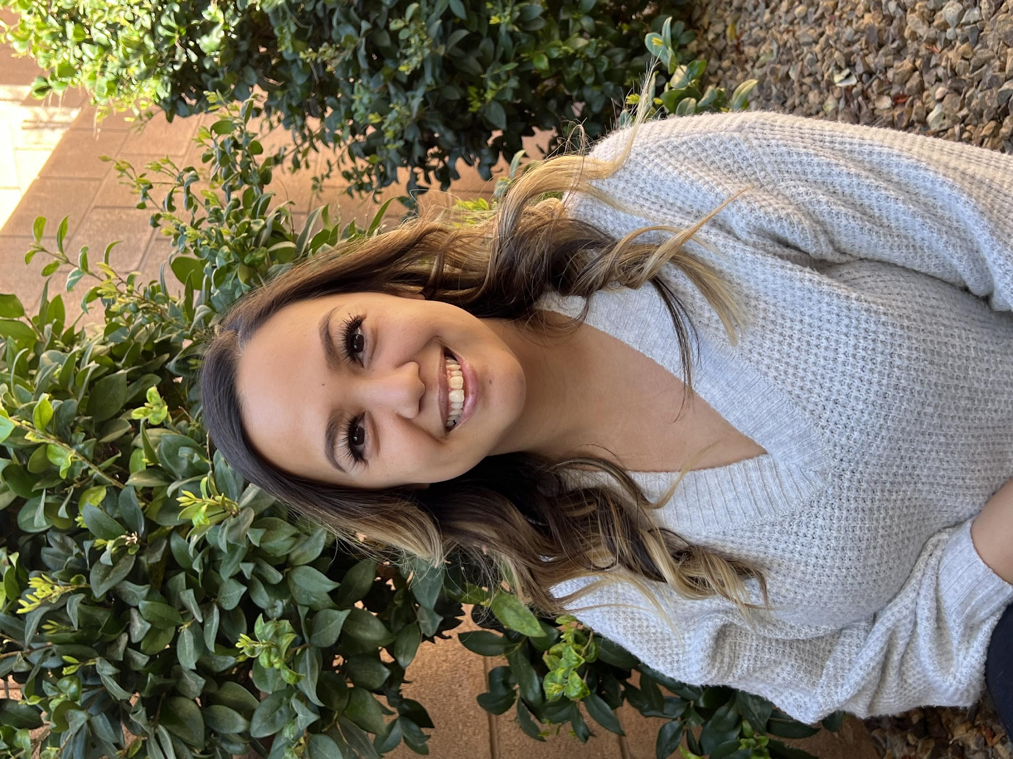
Meet the Locations and Groups Team
Region 1 Liaison Team
Terra Delong & Emily Carney
207-578-6277
region1@wreathsacrossamerica.org
Region 2 Liaison Team
Miesa Bland & Janelle Eveld
207-578-6283
region2@wreathsacrossamerica.org
Julie Bright
Director of Locations & Groups
Meagan Erickson
Asst. Director of Locations & Groups
Richelle Bergeson
Finance Liaison
Region 3 Liaison Team
Stephanie Molina & Ana Diaz
207-578-6287
region3@wreathsacrossamerica.org
Region 4 Liaison Team
Amber Rocha & David Koskelowski
207-578-6284
region4@wreathsacrossamerica.org
Region 5 Liaison Team
Tiffany Lynch & Annie Brooks
207-578-6289
region5@wreathsacrossamerica.org
Notes:
Here's the WAA Locations and Groups Team!

Slide 14
Thanks for Your Time

