Slide 1
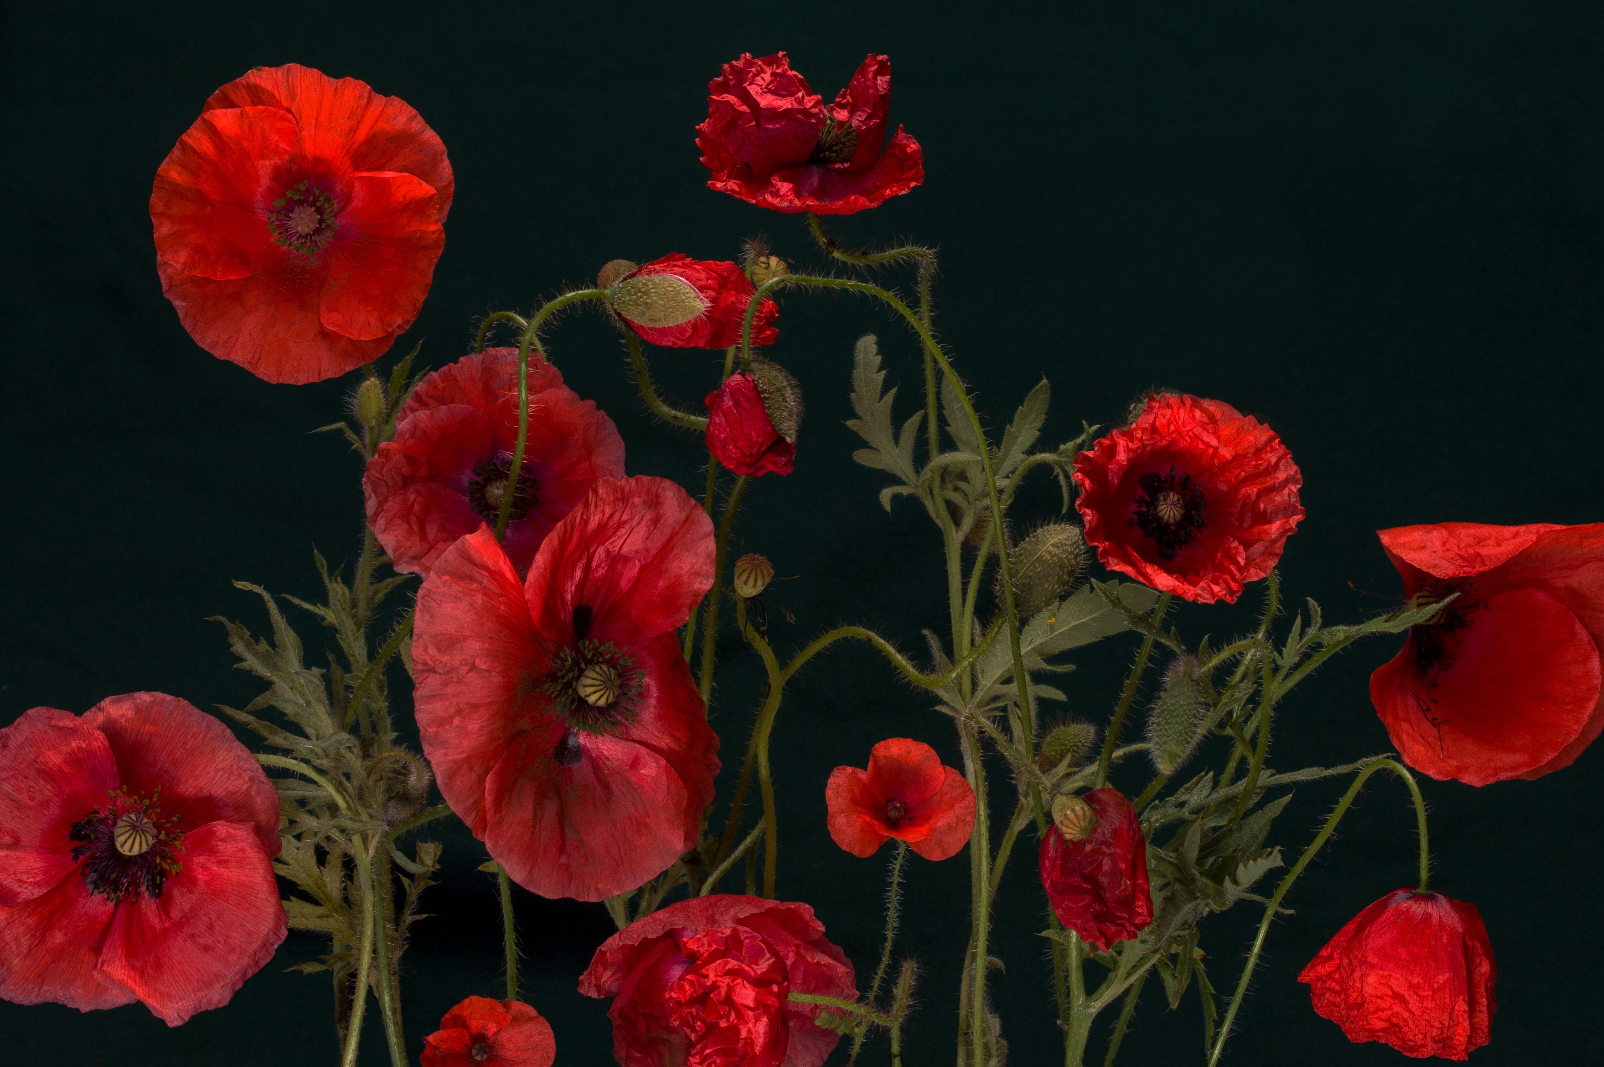
Memorial Day

Slide 2
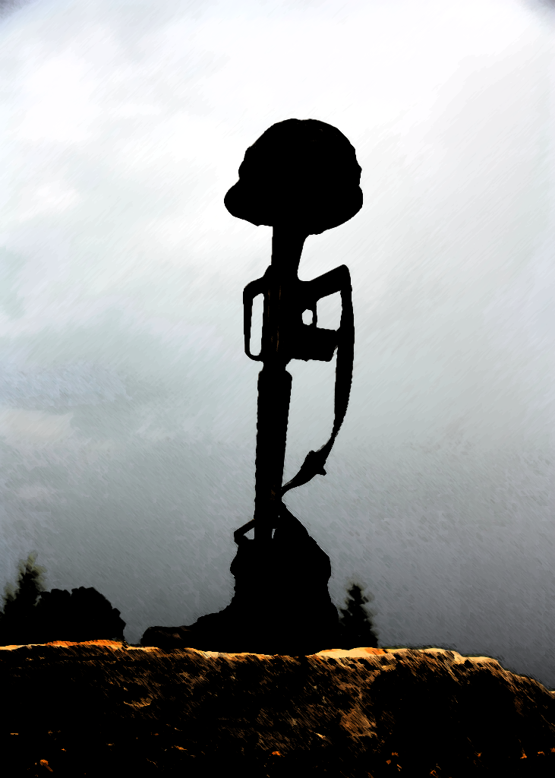
What is Memorial Day?
Memorial Day is a federal holiday in the United States. All government offices, including schools are closed.

Slide 3
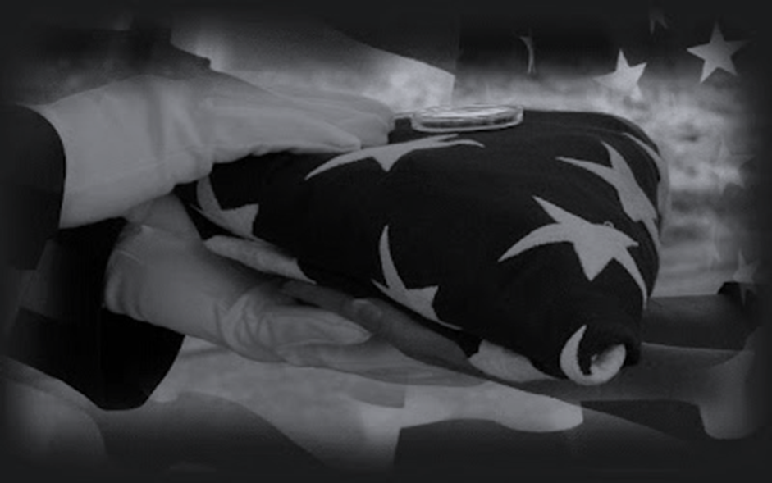
Memorial Day is the day we HONOR and REMEMBER those who have died while serving in our armed forces, protecting the many freedoms we enjoy in the United States.

Slide 4
When is Memorial Day?
Memorial Day is observed on the last Monday in May.

Slide 5
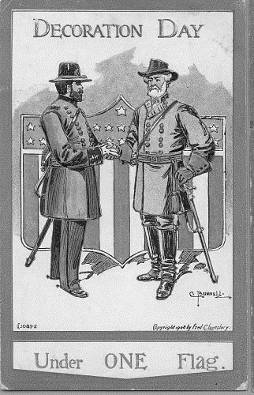
Memorial Day was originally known as Decoration Day.
It was called Decoration Day because family members went to burial sites and cemeteries to decorate the graves of loved ones who died in the Civil War.
Records show that one of the earliest commemorations of Decoration Day was organized by a group of former enslaved people in Charleston, South Carolina in 1865.

Slide 6
Many states started to observe Decoration Day in May. General John A. Logan, called for a nationwide day of remembrance on May 30, 1868, to honor those who died in the Civil War.
Some states started to squabble about which state started Decoration Day, and in 1966, President Lyndon Johnson declared Waterloo, NY as the “official” birthplace of Decoration Day.

Slide 7
Decoration Day originally honored only those who died while fighting in the Civil War.
However, during World War I the United States found itself embroiled in another major conflict, and the holiday evolved to commemorate American military personnel who died in all wars.

Slide 8
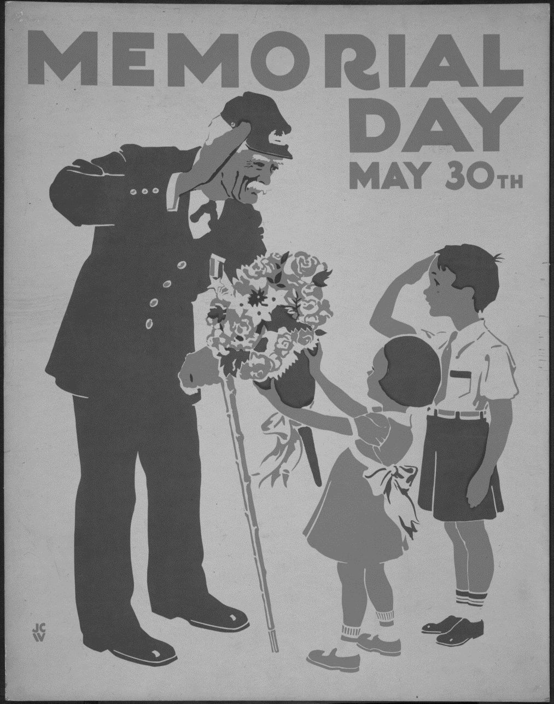
In 1968, Congress passed the Uniform Monday Holiday Act, which established Memorial Day as the last Monday in May. The change went into effect in 1971.
The same law also declared Memorial Day a federal holiday.

Slide 9
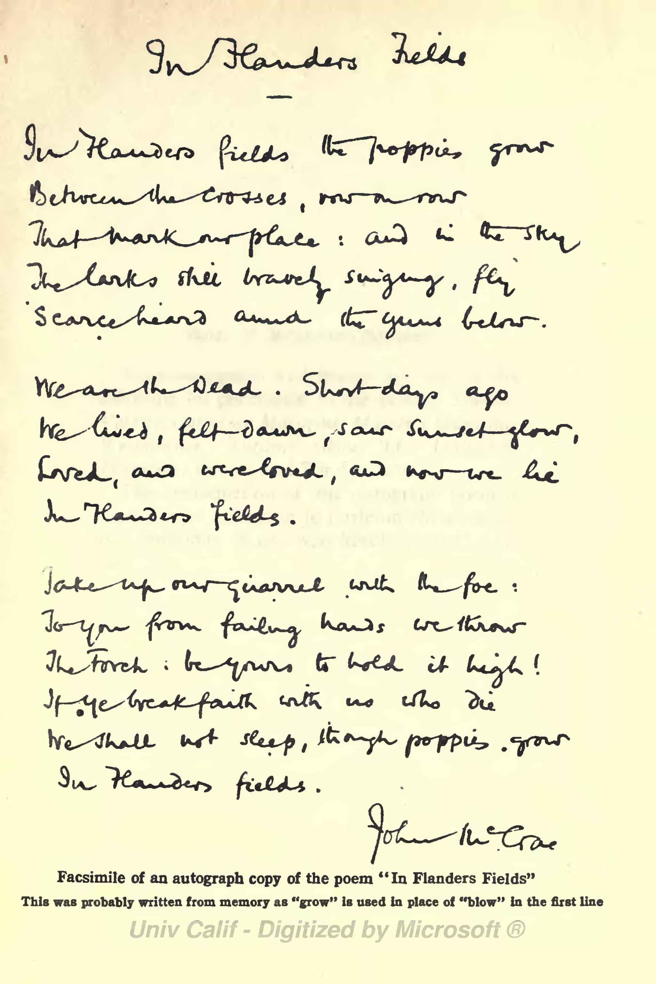
The official flower of Memorial Day is the Red Poppy.
The poppy was chosen because of a poem written by Dr. John McCrae in 1915, called, “In Flanders Fields.” McCrae wrote the poem as a tribute to a friend who died in battle.
The poem was first published during the war under the title,
“We Shall Not Sleep.”

Slide 10
In 1918, two days before the signing of the Armistice to end WWI, Moina Michael, an educator and volunteer with the overseas YMCA war workers at Columbia University in New York, read the poem again, in a magazine. In her book, The Miracle Flower, she wrote about the experience as being “deeply spiritual.” She said, “She felt as though she was actually being called by the voices which had been silenced by death.”

Slide 11
In 1918, Michael wrote her poetic response to “In Flanders Fields,” entitled “We Shall Keep the Faith.” Moina then set about the arduous task of having the Red Poppy recognized as the National Flower of Remembrance. She traveled across the country and wrote hundreds of letters to congressmen. Finally, in 1920, she found an ally for her cause, the American Legion.
We Shall Keep the Faith
Moina Michael
“Oh! you who sleep in Flanders Fields, Sleep sweet — to rise anew! We caught the torch you threw And holding high, we keep the faith With all who died.
We cherish, too, the poppy red That grows on fields where valor led; It seems to signal to the skies That blood of heroes never dies, But lends a luster to the red Of the flower that blooms above the dead In Flanders Fields.
And now the torch and poppy red We wear in honor of our dead. Fear not that you have died for naught; We’ll teach the lesson that you wrought In Flanders Fields.

Slide 12
On September 27, 1920, the poppy became the official flower of The American Legion family. The American Legion Family brought National Poppy Day® to the United States by asking Congress to designate the Friday before Memorial Day, as National Poppy Day. In 1920, Congress passed a bill to make the poppy the official flower of remembrance. In 1924, the distribution of poppies became a national program of The American Legion.

Slide 13
Led by the American Legion Auxiliary, each year members of The American Legion Family distribute poppies with a request that the person receiving the flower make a donation to support the future of veterans, active-duty military personnel and their families with medical and financial needs.

Slide 14
Remember to wear a red poppy on the Friday before Memorial Day in remembrance of those who have paid the ultimate sacrifice for our Freedom.

