Slide 1
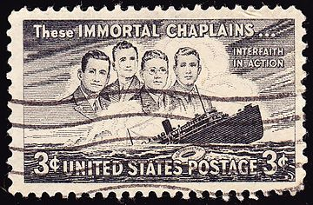
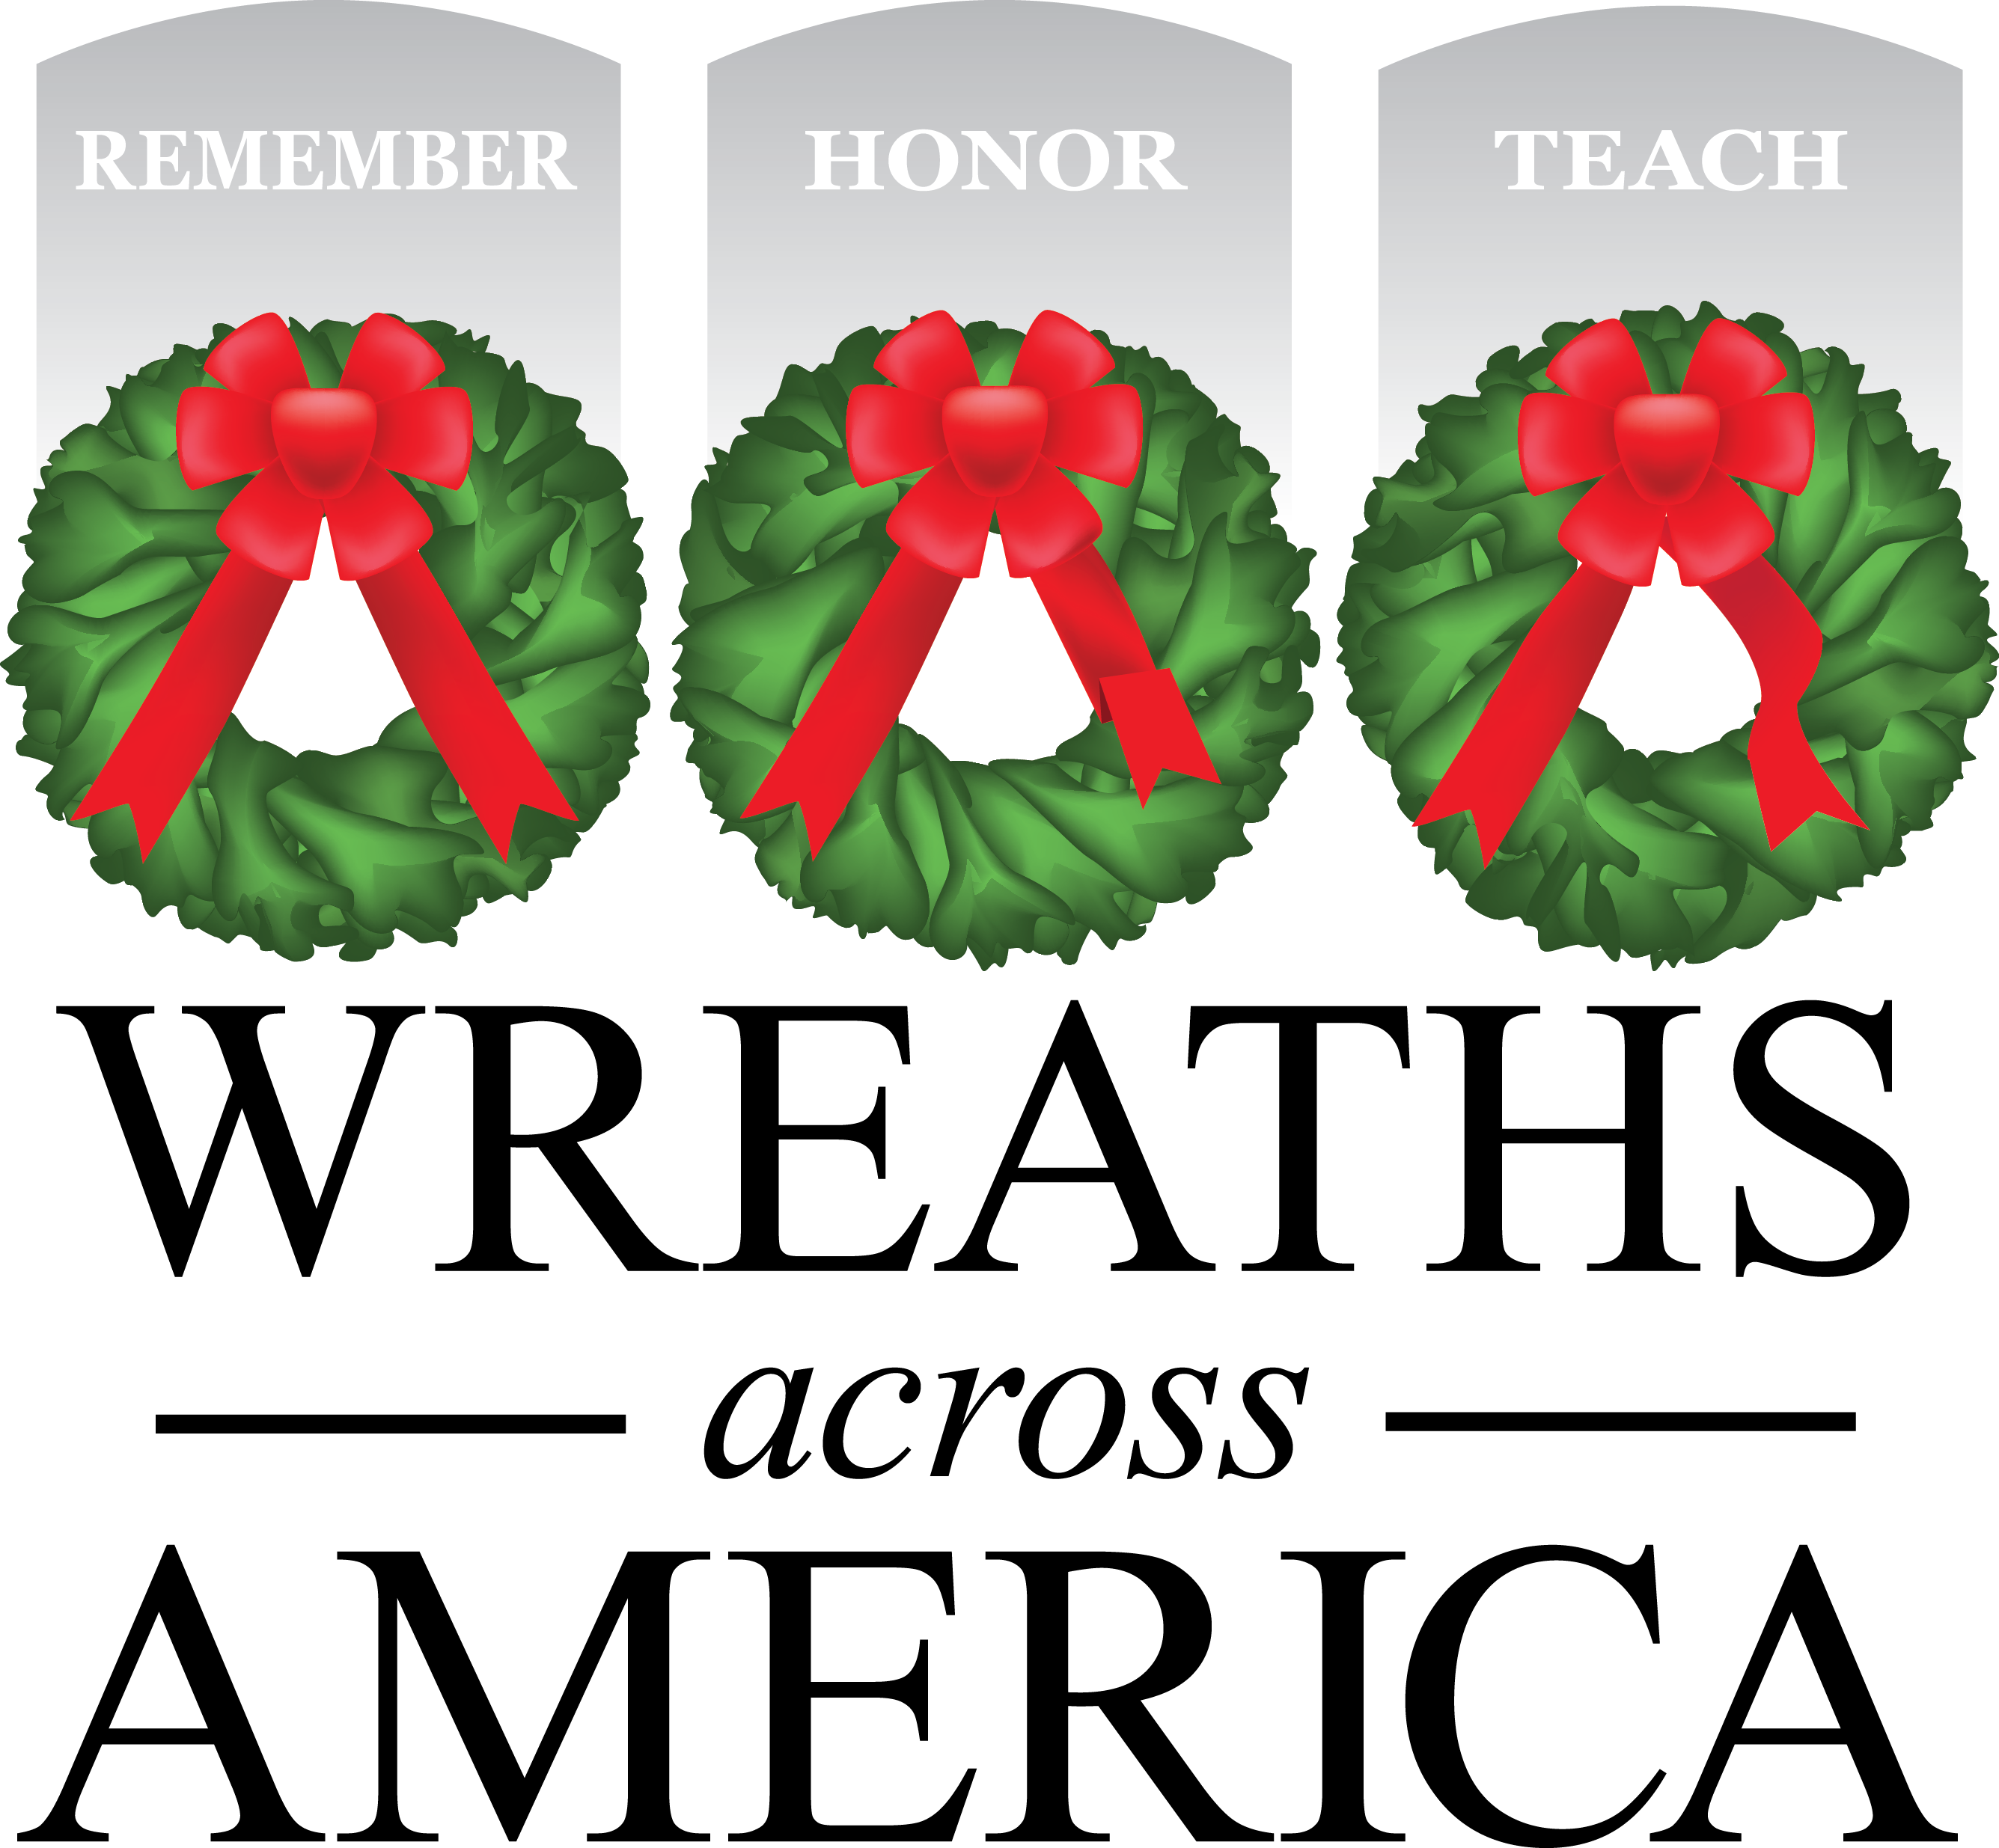
The Four Chaplains

Slide 2
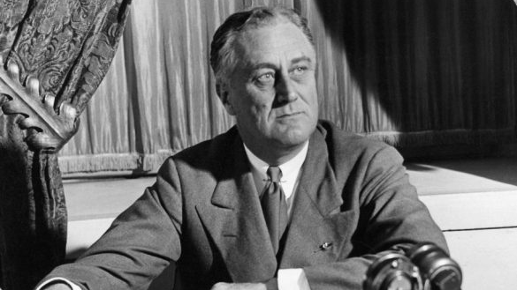
During World War II, the United States needed ships to transport troops and materials to other countries.
President Franklin Roosevelt created the War Shipping Administration so the military could use ships that were already built.
This meant the government did not have to wait a long time to build ships.
This Photo by Unknown Author is licensed under CC BY-NC

Slide 3
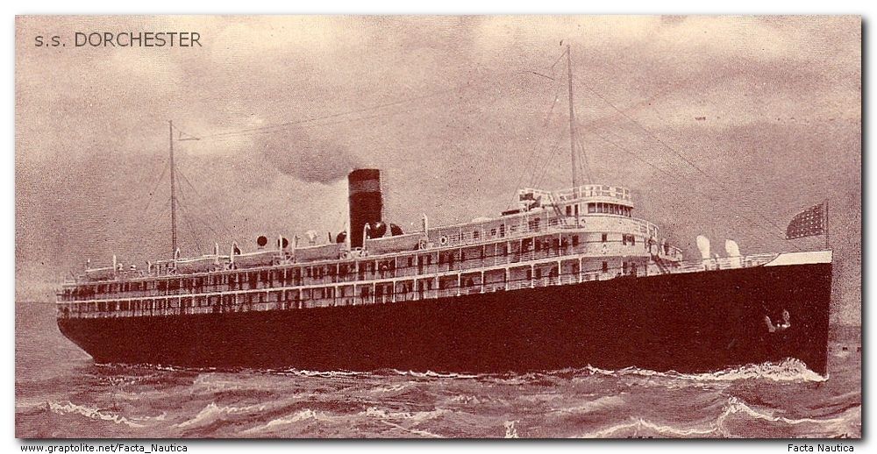
The Dorchester was a luxury cruise liner with accommodations to carry 300 passengers and 90 crew members before the War Shipping Administration acquired it for use.
On January 23, 1943, the USAT Dorchester left New York harbor bound for Greenland carrying 902 officers, servicemen and civilian workers.

Slide 4
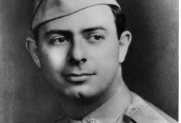
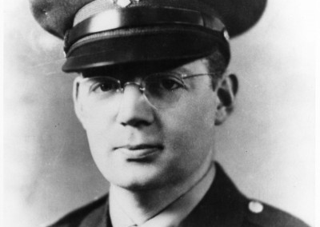
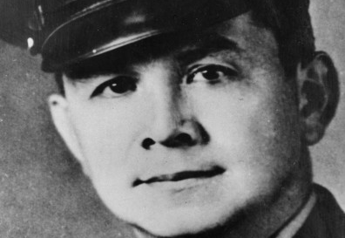
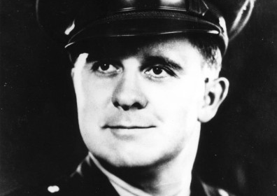
On board the Dorchester were four U.S. Army Chaplains:
Lt. Alexander D. Goode, Lt. John P. Washington, Lt. George L. Fox, and Lt. Clark V. Poling.

Slide 5
In November 1942, the four men met while attending Chaplain's School at Harvard University.
The chaplains found out they had a lot in common, despite being from different religious backgrounds, and they quickly became good friends.
A common cause brought them together, the desire to serve their country during World War II.
On board the ship, one of their job responsibilities in addition to ministering to the troops, was to keep the morale of the soldiers high. The chaplains worked together to organize talent shows, game nights and other activities for the troops!

Slide 6
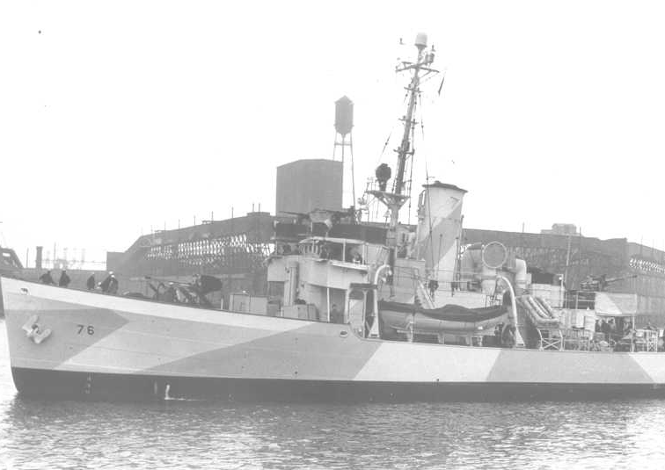
Because it was war time, and the seas were full of German submarines called U-Boats, the Dorchester and two other ships were being escorted by three Coast Guard cutters.
On February 2, one of the Coast Guard cutters received sonar readings indicating the presence of an enemy submarine in a place known as "Torpedo Junction".

Slide 7
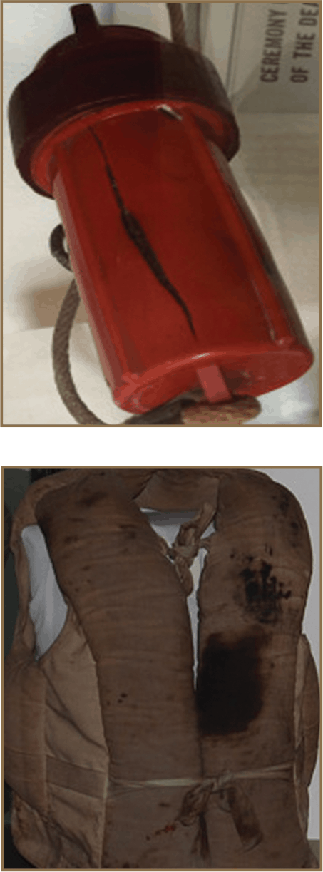
That evening, the Commanding Officer of the Dorchester ordered the men to sleep in their clothing, with their life jackets close at hand.
The ships were only 150 miles from their destination in Greenland, and if they could make it through the night, the ships would have air cover from the American base in Greenland in the daylight hours.

Slide 8
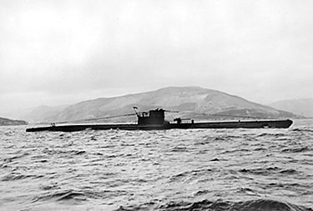
Down in the ship’s crowded hold, the four chaplains circulated among the frightened young men-talking to them, trying to calm their fears about the German U-Boat.

Slide 9
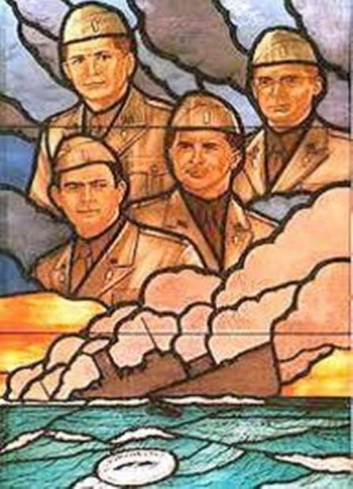
At 1:00 in the morning on February 3, the chaplains were still awake when the torpedo struck. The missile exploded in the boiler room, destroying the electric supply, and releasing suffocating clouds of steam and gas. The explosion threw soldiers from bunks and the lights went out as the ship started to sink.

Slide 10
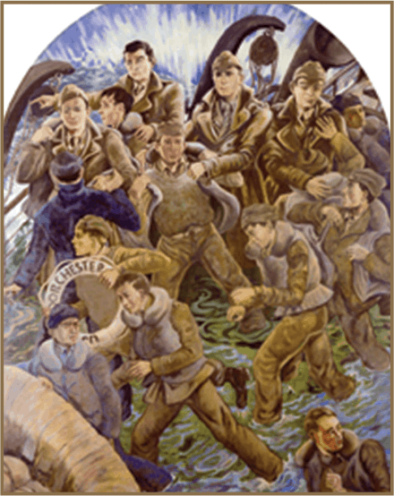
Those not killed in the explosion or trapped below deck, rushed topside. Dazed and disoriented, the men stumbled about on the dark, crowded decks.
The four chaplains acted quickly, calming the men, and directing them to life rafts. They urged them to escape the ship. Some of the men gripped the rails of the ship, too afraid to move to the lifeboats.
Many had forgotten their life jackets. The chaplains located a supply in a deck locker and passed them out. When the bin was empty, they pulled their own life jackets off and made other crew members put them on.

Slide 11
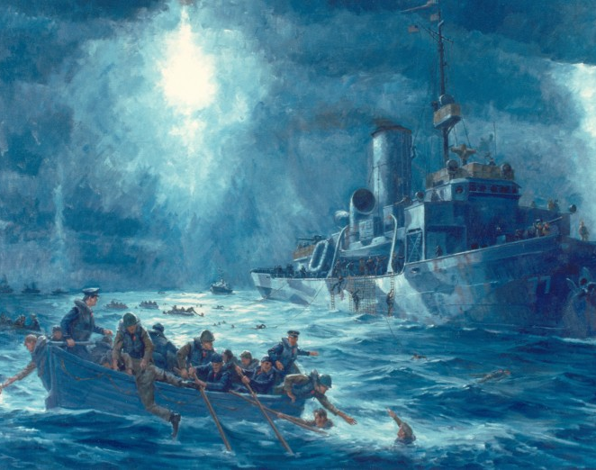
Only two of the 14 lifeboats could be used to abandon the ship, the others were coated in ice.
Soldiers jumped into the frigid water. They held on to the gun rest of the two overcrowded lifeboats, clung to doughnut shaped rafts or floated alone.
Two of the Coast Guard Cutters moved into action to try to save the men.

Slide 12
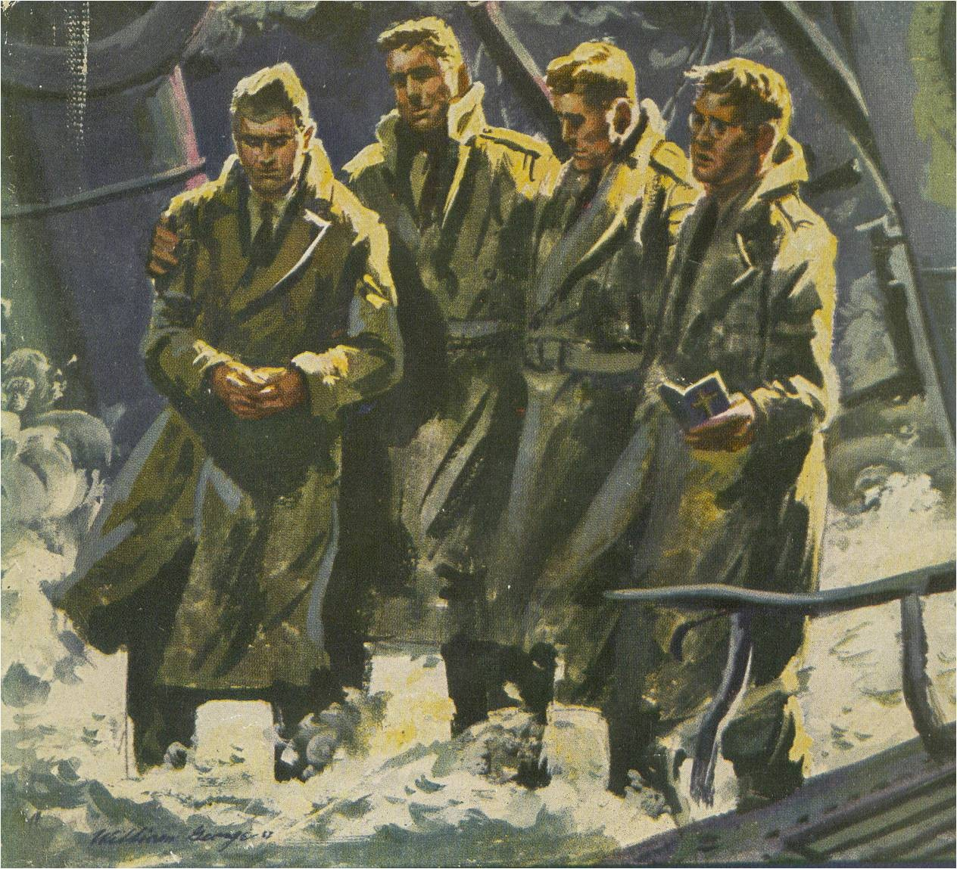
The four chaplains remained on the ship’s deck, standing together, arms linked, heads bowed in prayer, as the Dorchester slipped beneath the water 27 minutes after being struck by the torpedo.
Out of the 902 people on board the Dorchester, 230 survived, 672 people, including the four chaplains, perished in the waters of the icy Atlantic Ocean.

Slide 13
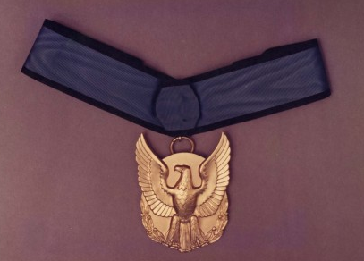
In 1948, the U.S. Post Office issued a commemorative stamp in honor of the heroism and sacrifice of the Four Chaplains.
Congress established February 3 as "Four Chaplains Day."
The Chaplain's Medal for Heroism, was presented posthumously to the next of kin of the Four Chaplains in 1961. This medal has only been awarded one time.

