Slide 1
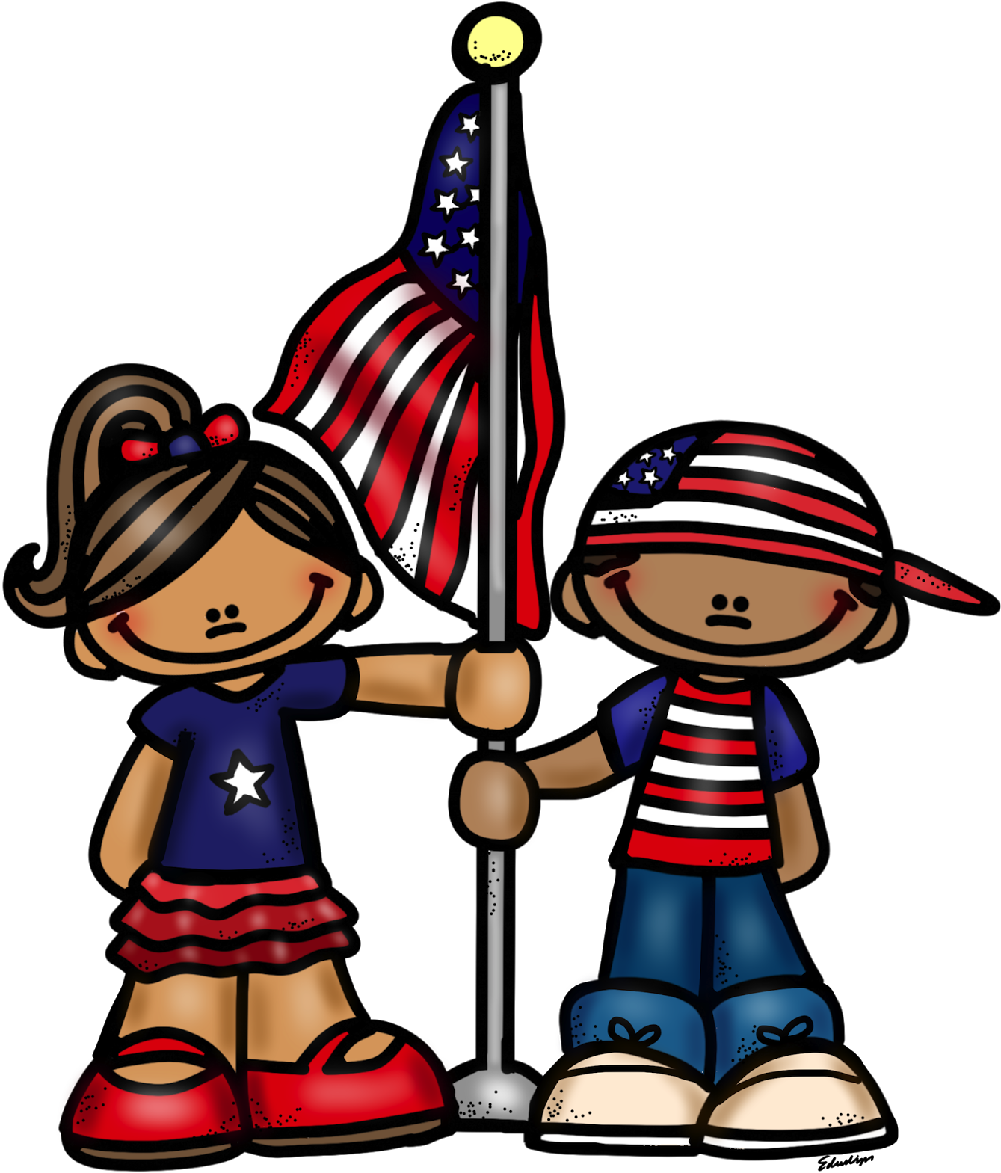
What is Memorial Day?

Slide 2
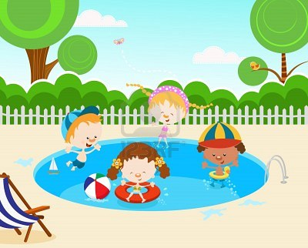
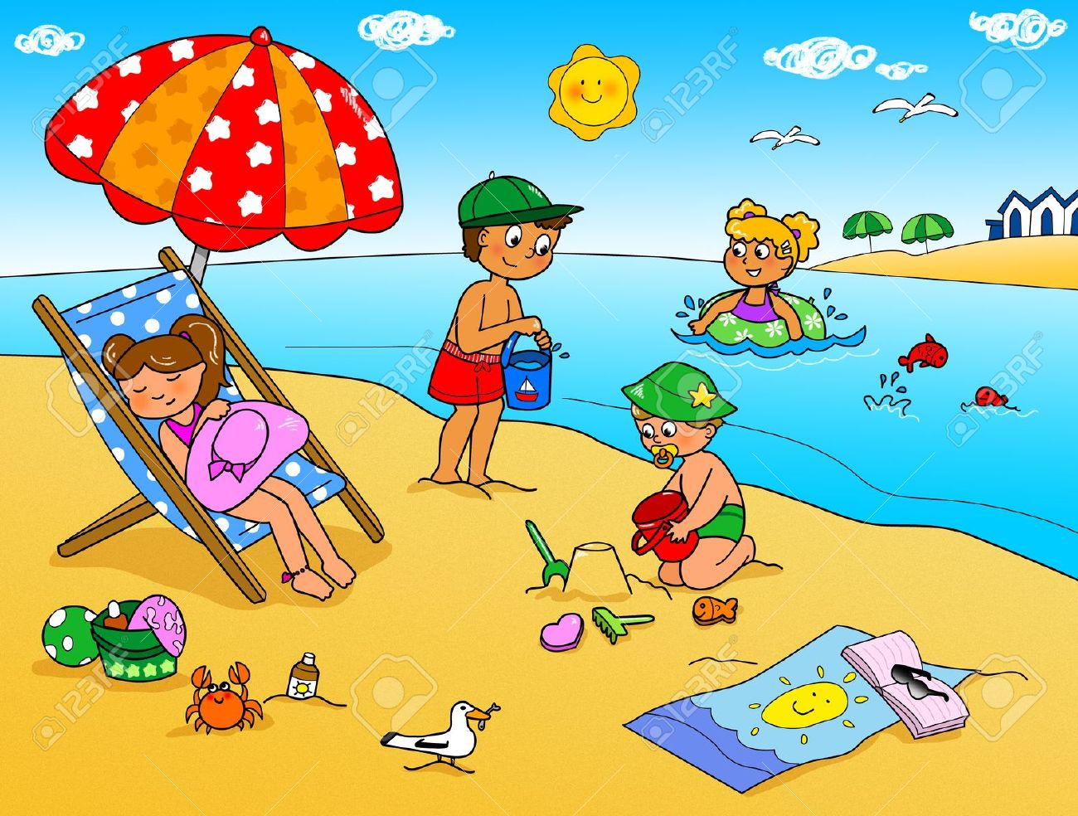
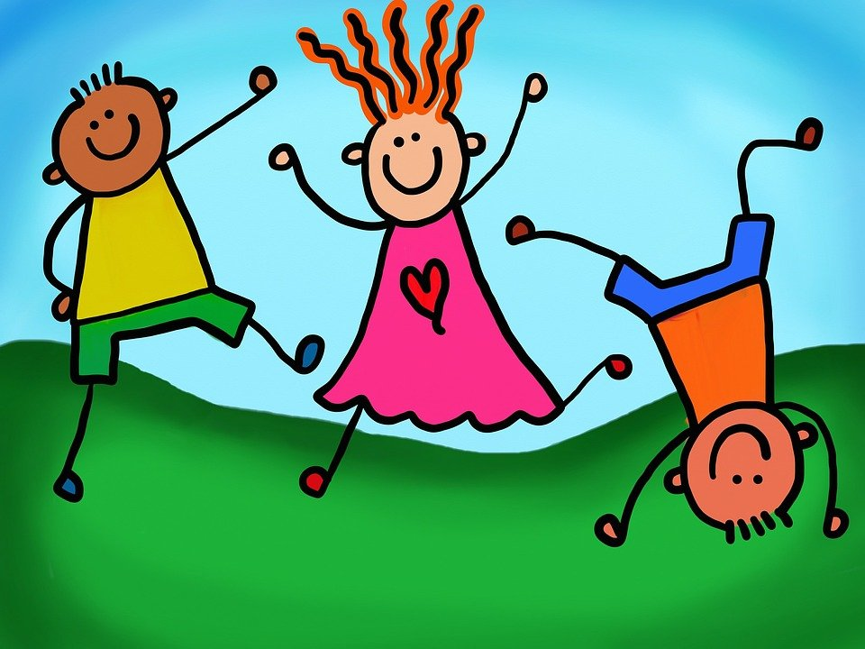
Some people celebrate Memorial Day as the beginning of summer…

Slide 3
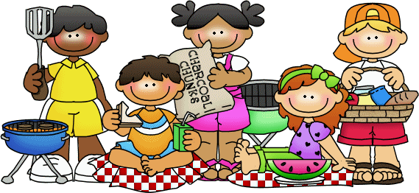
some people have a picnic with family and friends,

Slide 4
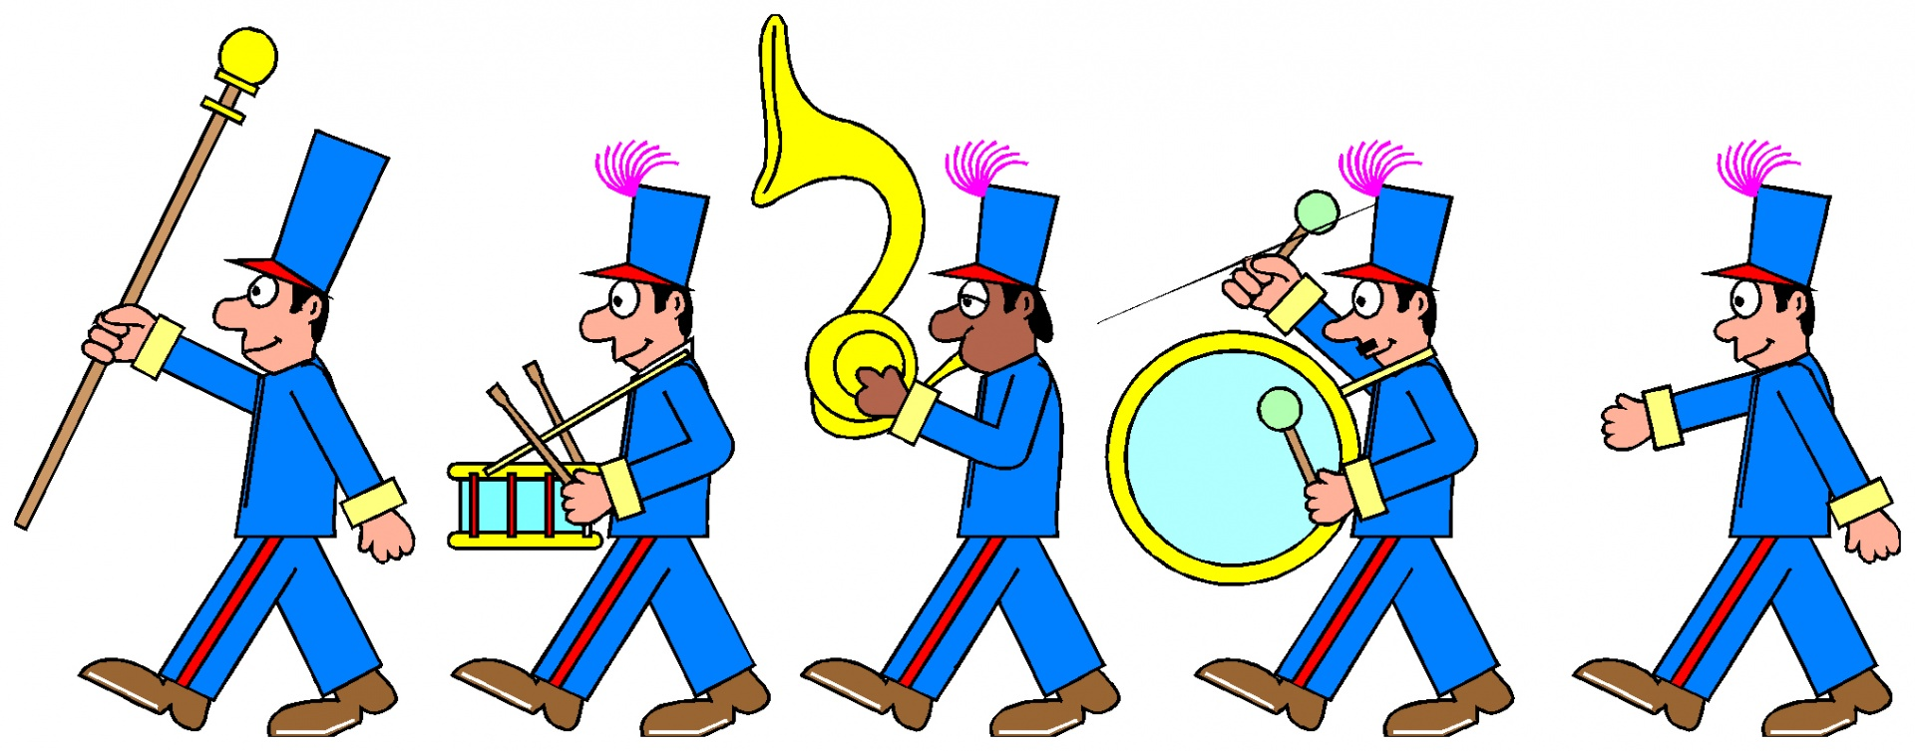
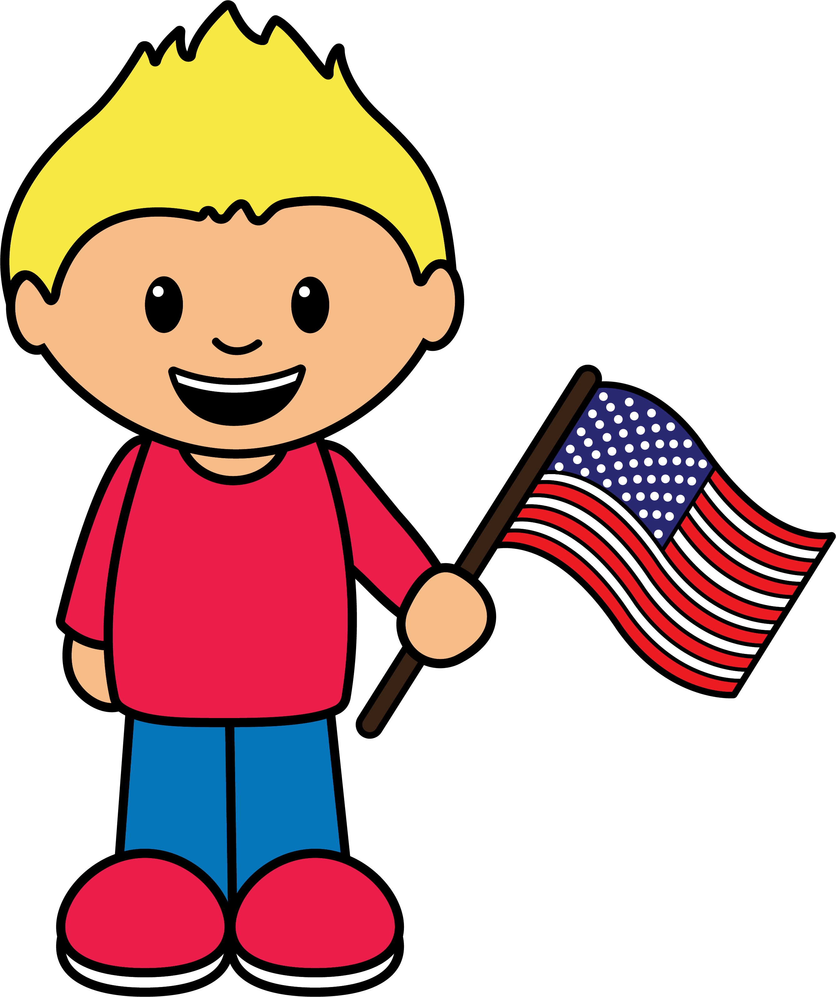
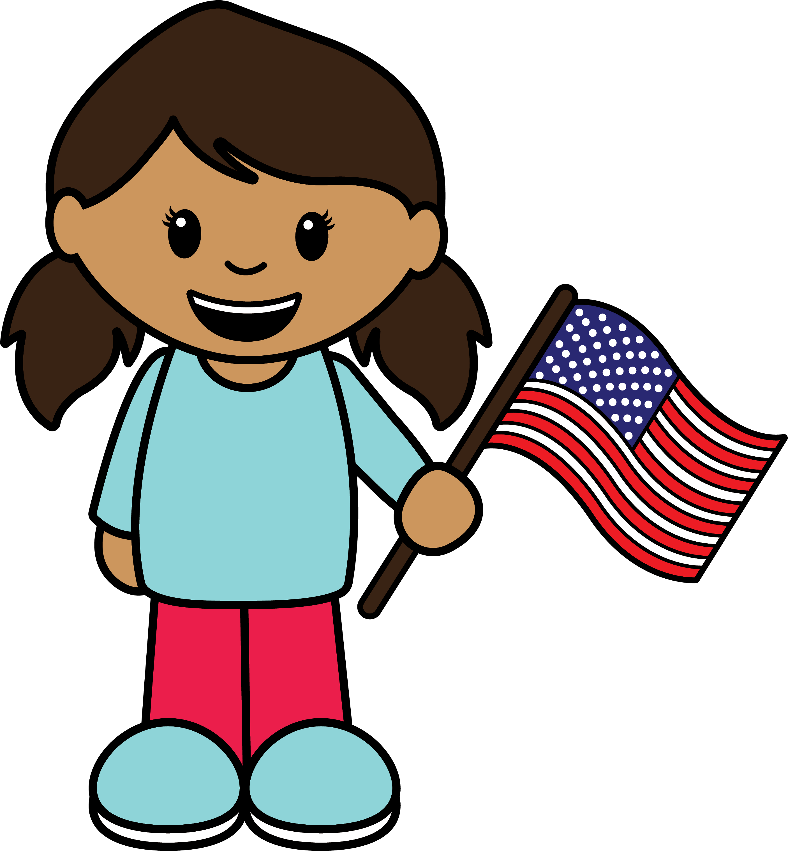
and some people go to a parade.

Slide 5

But Memorial Day is about a lot more than summer vacations, picnics or parades.
Memorial Day is a national holiday in the United States.
We observe Memorial Day on the last Monday in May.
MAY

Slide 6
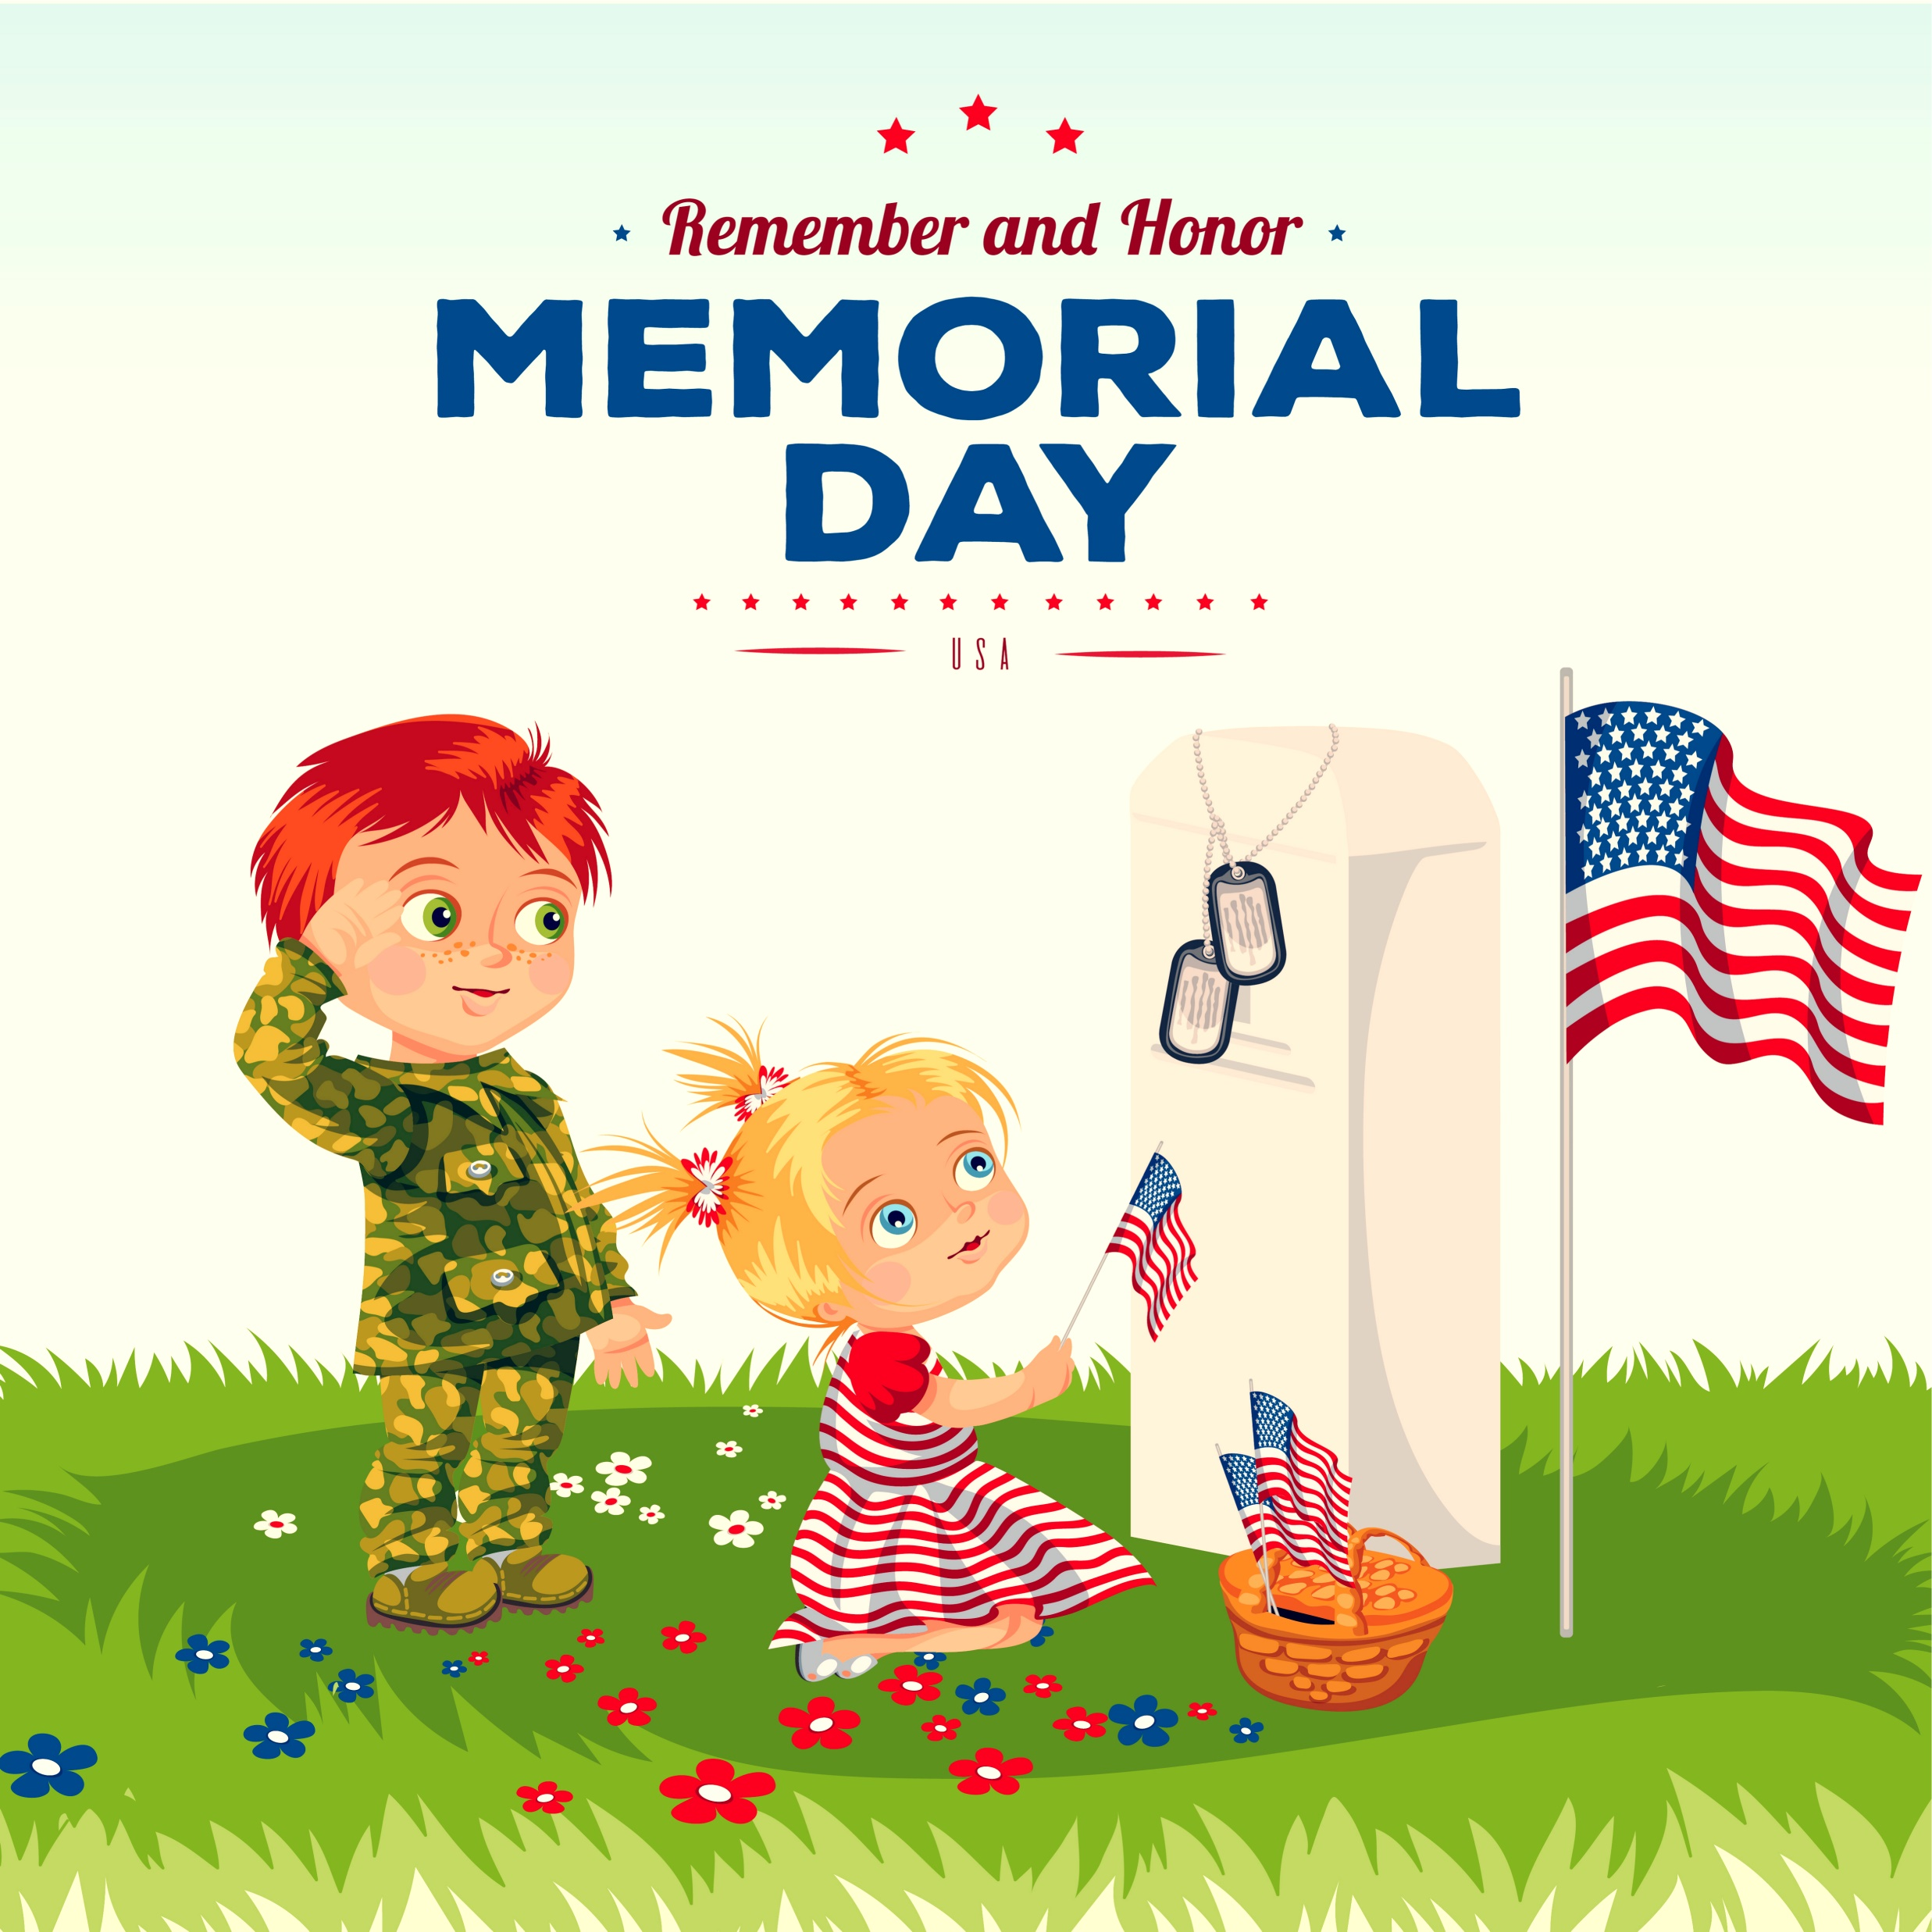
Memorial Day is the day we HONOR those who have died while in the armed forces protecting the many freedoms we enjoy in our country.

Slide 7
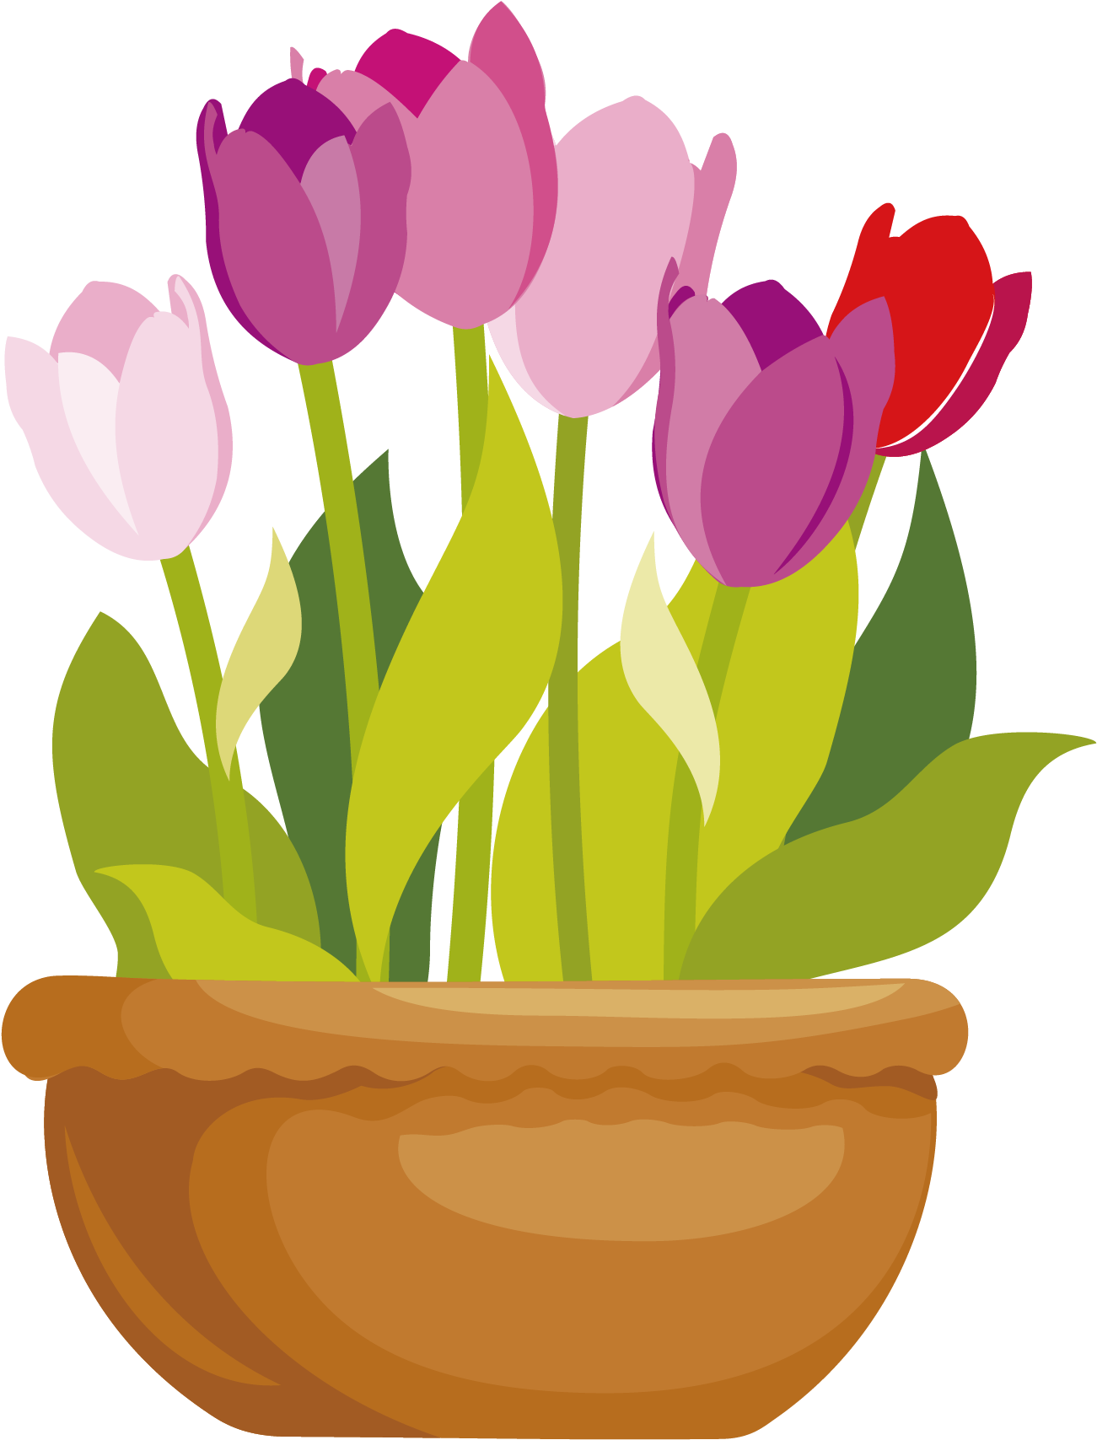
Memorial Day was first known as Decoration Day. It started in 1868, after the end of the Civil War.
Family members went to the burial sites and cemeteries of loved ones who died in the war, to place flowers on the graves.
This Photo by Unknown Author is licensed under CC BY-NC
This Photo by Unknown Author is licensed under CC BY-NC
This Photo by Unknown Author is licensed under CC BY-NC

Slide 8
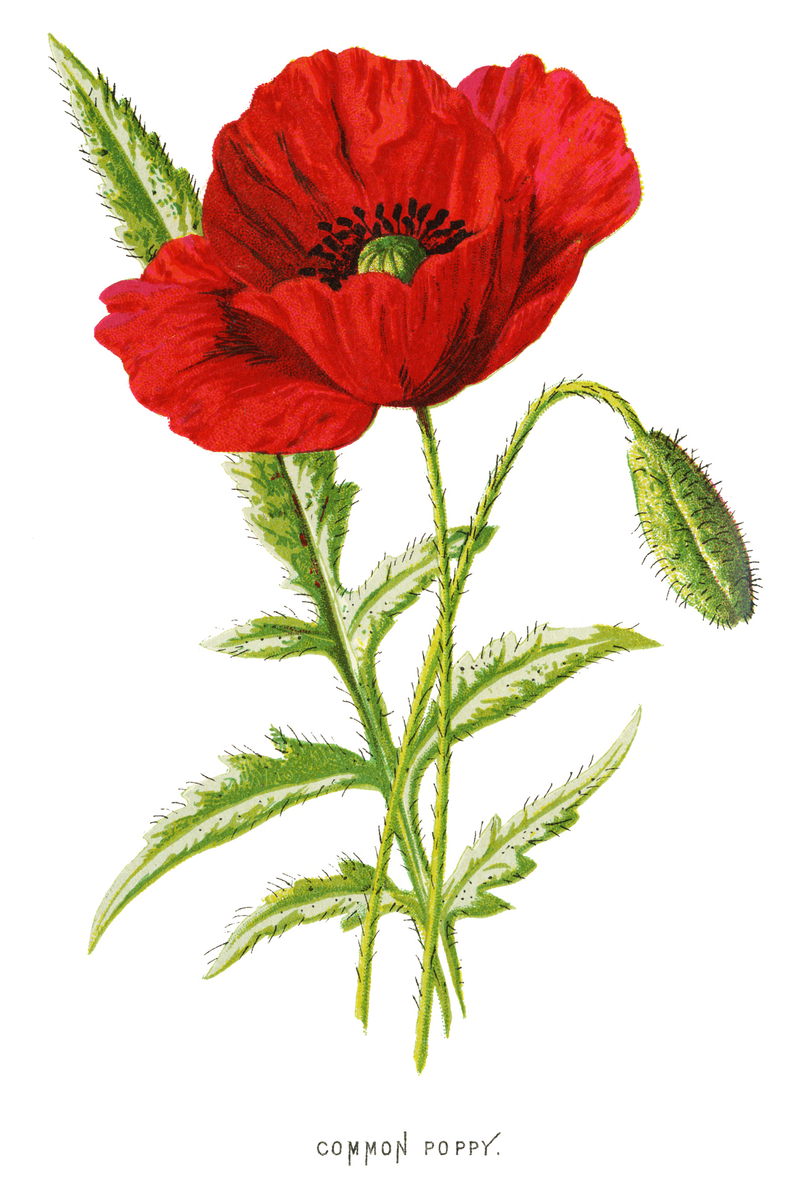
The Official flower of Memorial Day is the Red Poppy. The poppy was chosen because of a poem called, “In Flanders Fields.”
The US Congress passed a bill in 1920 to make it official.

Slide 9
How can YOU HONOR our fallen heroes on Memorial Day this year?

