Slide 1
Flag Day
June 14

Slide 2
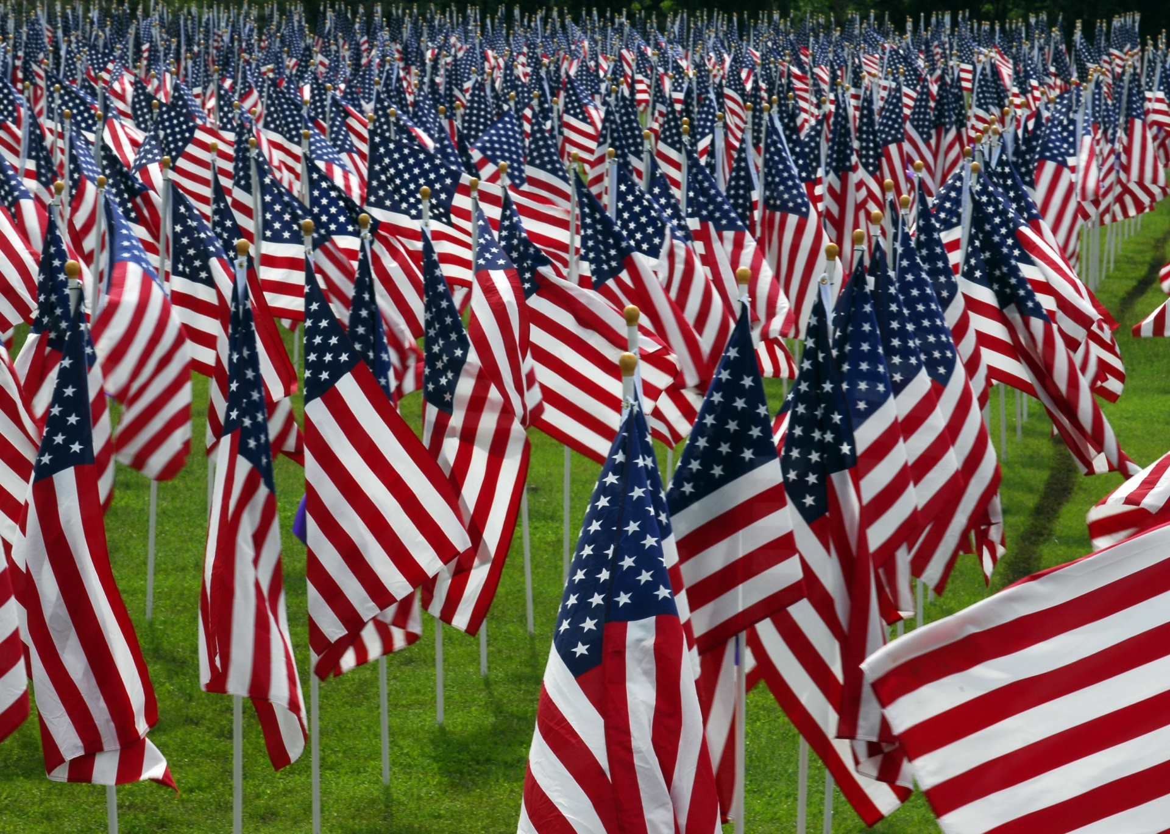
One of the most recognized symbols of freedom in the world today is the flag of the United States of America.

Slide 3
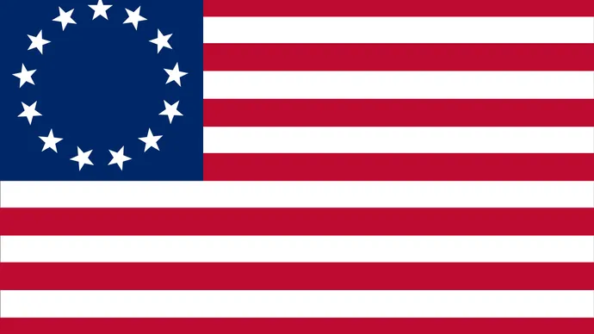
Nicknames for the United States Flag:
Stars and Stripes
Old Glory
The Star-Spangled Banner
The Red, White, and Blue
The American Flag

Slide 4
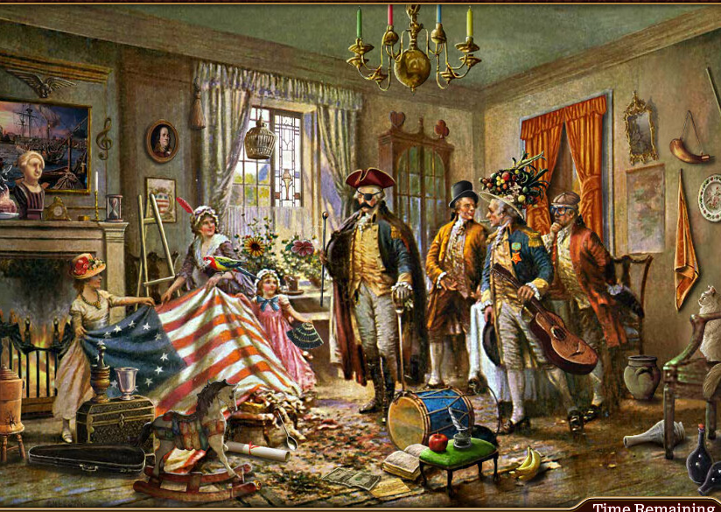
Betsy Ross is often given credit for making the first “official” flag of the United States, but there are those who believe the flag was designed by Francis Hopkinson.

Slide 5
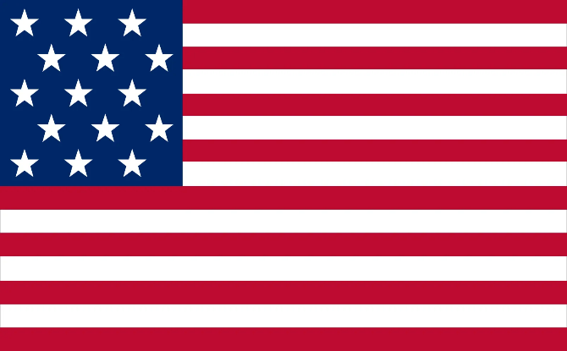
There have been 27 versions of the Flag of the United States of America, 25 of those involved changes in the number and design of the stars.

Slide 6
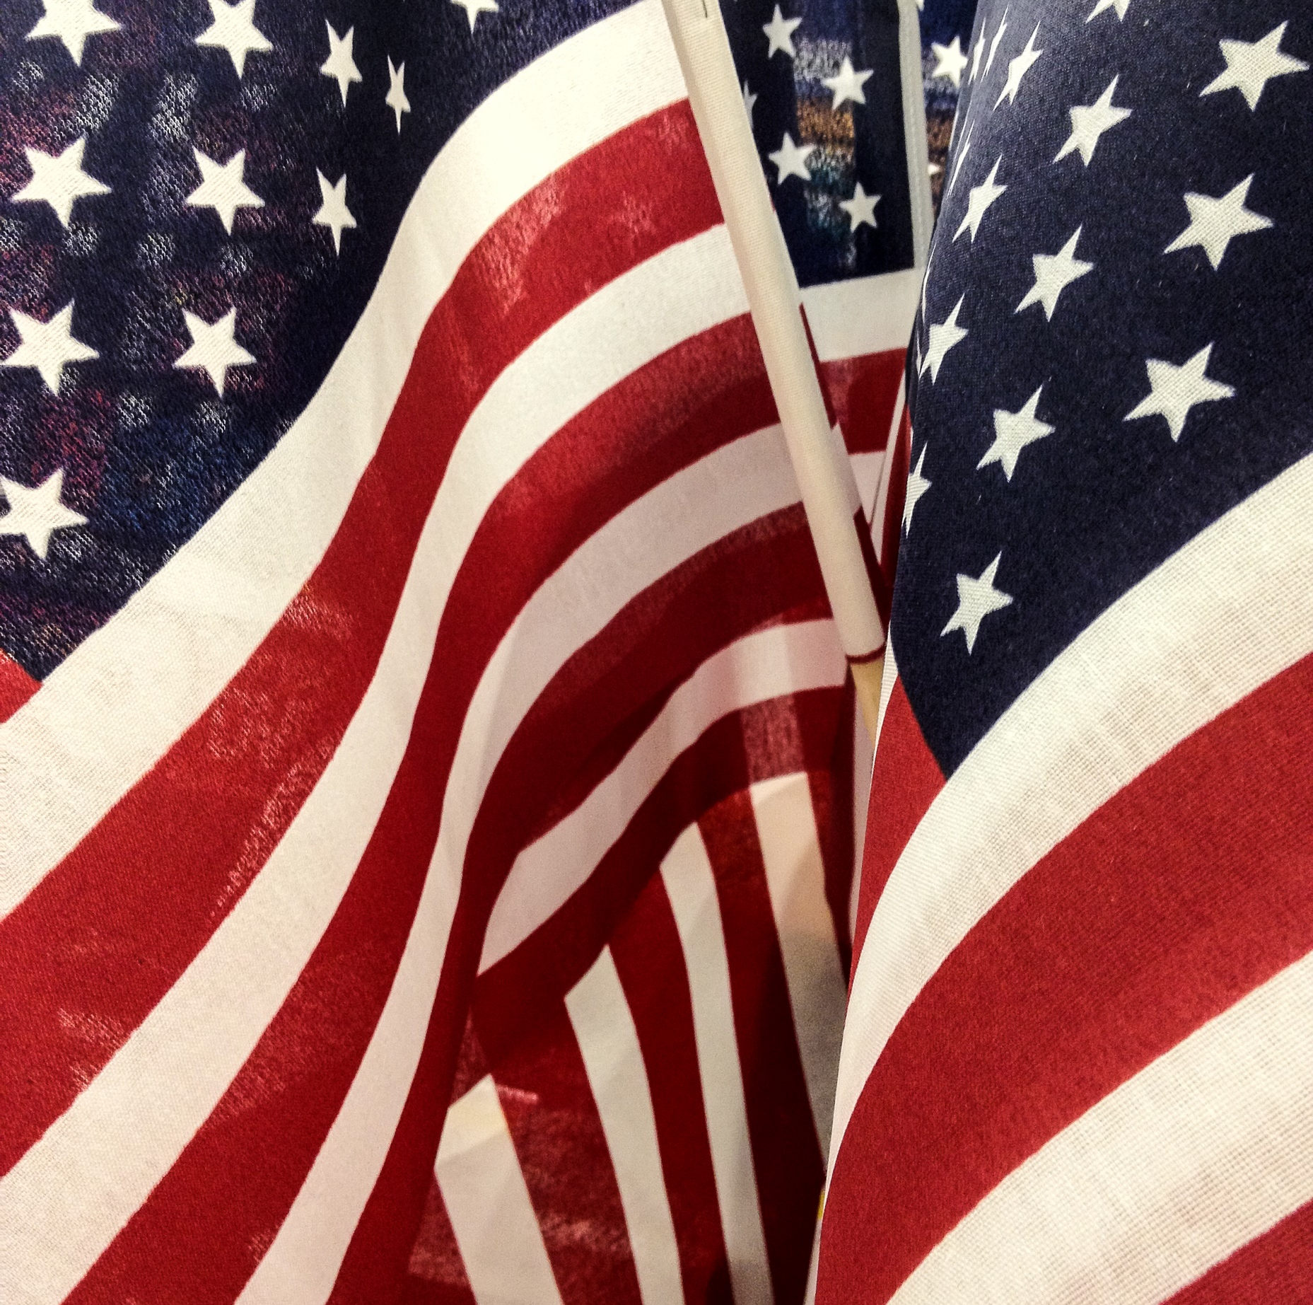
As states have been added to the country, a star has been added to represent the state.
The American Flag has 13 stripes, representing the 13 original colonies and 50 stars.

Slide 7
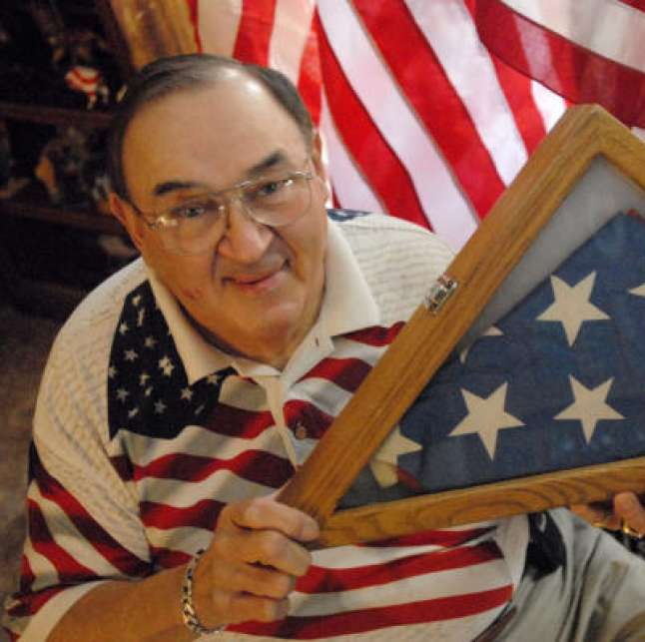
Bob Heft, was a 17-year-old Junior in high school, when he designed a United States Flag with 50 stars for a history class project.
Bob’s teacher gave him a B- on the project, but changed the grade to an A, when his design was chosen as the new American Flag!!

Slide 8
Questions:
When do we celebrate Flag Day?
Why is the American Flag recognized all over the world?
What are four nicknames for the American Flag?
Who is given credit for sewing the first American Flag most of the time?
How many stripes does the American Flag have?
When are stars added to the American Flag?
How many stars does the American Flag have now?

