Slide 1
Who Were the Buffalo Soldiers?

Slide 2
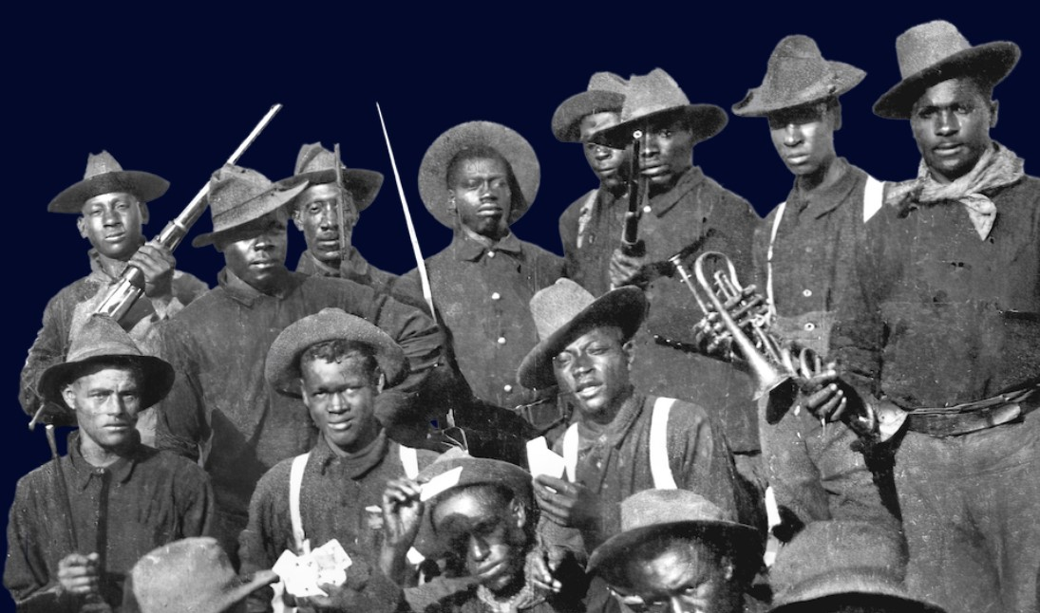
When the Civil War ended, the United States Congress passed a law in 1866 authorizing the U.S. Army to form cavalry and infantry regiments of African American men.

Slide 3
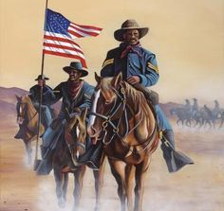
Buffalo Soldiers was the nickname given to members of the 2 African-American cavalry and 4 infantry regiments of the U.S. Army.

Slide 4
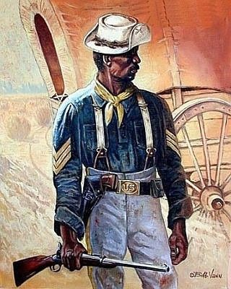
It is said that their combat skills and bravery on the battlefield, and their black curly hair inspired the Cheyenne Indians to call them the Buffalo Soldiers.

Slide 5
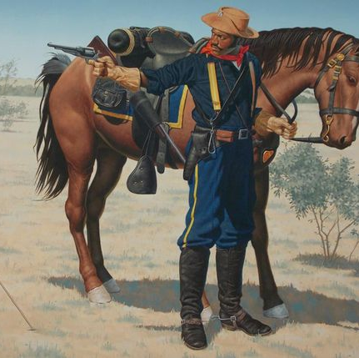
It was a name that symbolized the Native Americans respect for the Buffalo Soldiers’ bravery and valor.

Slide 6
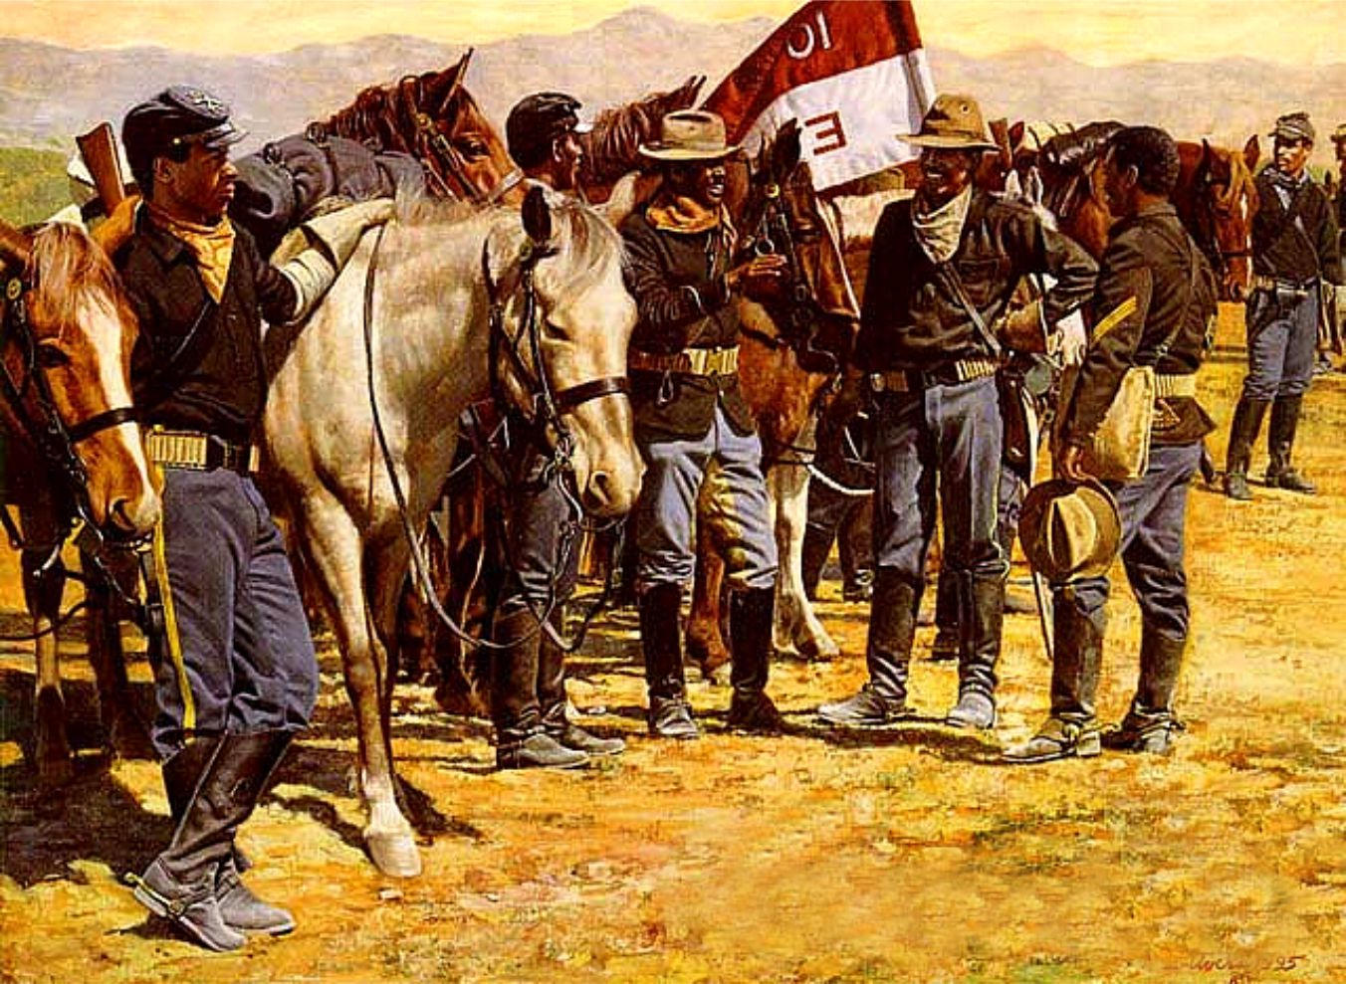
The Buffalo Soldiers wore the name with pride.

Slide 7
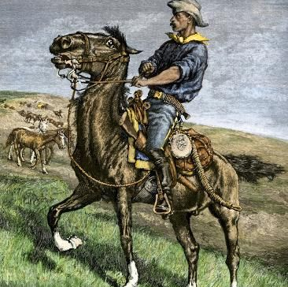
Many of the young men who served in these units were former slaves.
They wanted a life with more opportunities after the Civil War.

Slide 8
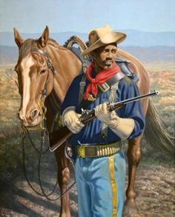
The military offered former slaves more opportunities than they had in the south.

Slide 9
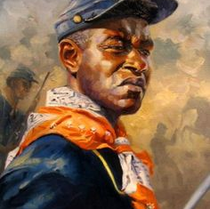
The Buffalo Soldiers became pioneers of Westward expansion and participated in every major conflict of the late nineteenth and early twentieth Centuries.

Slide 10
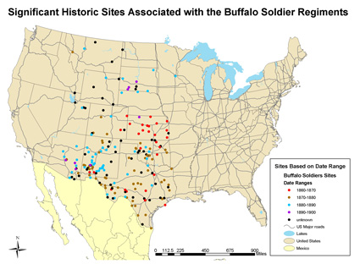
Arizona
Colorado
Idaho
Iowa
Kansas
Montana
Nebraska
New Mexico
Oklahoma
Texas
Utah
Wyoming

Slide 11
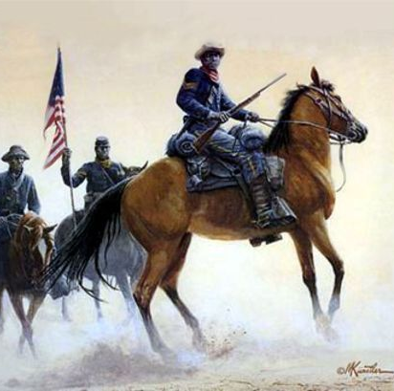
During the Indian Wars, thirteen enlisted men and six officers from the four regiments earned the nation’s highest military honor, the Congressional Medal of Honor.

Slide 12
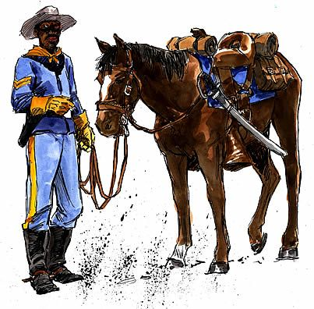
The Buffalo Soldiers also served in the Spanish-American War, the Philippine-American War, the Mexican Border War, World War I, and World War II.

Slide 13
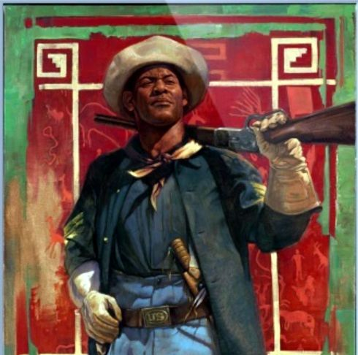
President Harry S. Truman ordered an end to separation of military troops by race.
In 1951, during the Korean War, the Buffalo Soldier regiments were moved into other units.

Slide 14
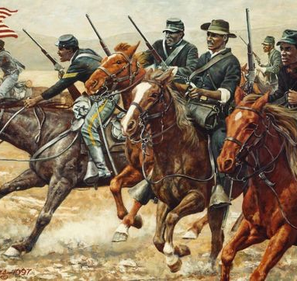
African American men, have fought in every American war, which has earned the Buffalo Soldiers a unique place in the history of the United States.

Slide 15
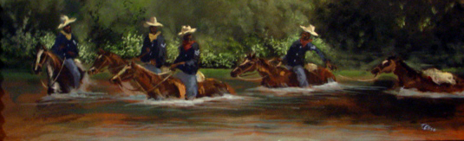
In addition to their participation in military campaigns, the work of the Buffalo Soldiers was very important to westward expansion. They built forts and roads, installed miles of telegraph wires, escorted the U.S. mail and stagecoaches, and helped establish the National Parks in the west.

Slide 16
For all of their contributions to our country, we celebrate Buffalo Soldiers Day on July 28th of each year.

